Slide 1



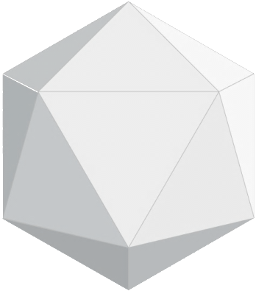

2021
中青工业

Slide 2
CONTENTS
目 录
Company
Profile
Product Service
Business Development
Contact
Us

Slide 3
01 Company Profile

Slide 4
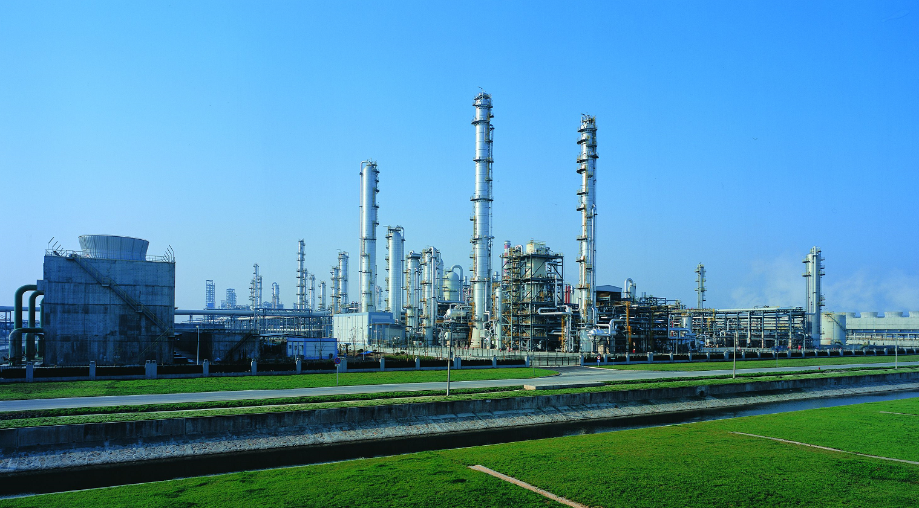
COMPANY
INTRODUCTION
MIT -IVY Industry Co.,Ltd. is a leading manufacturer and trader of chemical for 16 years which has established its own 4 factories with complete production equipment and meticulous management and maintenance of machinery.We use advanced production technology and test methods to realize production, quality controlling to meet the standard. We have been approved by SGS, ISO9001, ISO140 01, GB/HS16949 and T28001.

Slide 5



TEAM
INTR
ODUCTION
1
2
3
Athena Fan
Joyce Zhang
Kelley Qi

Slide 6
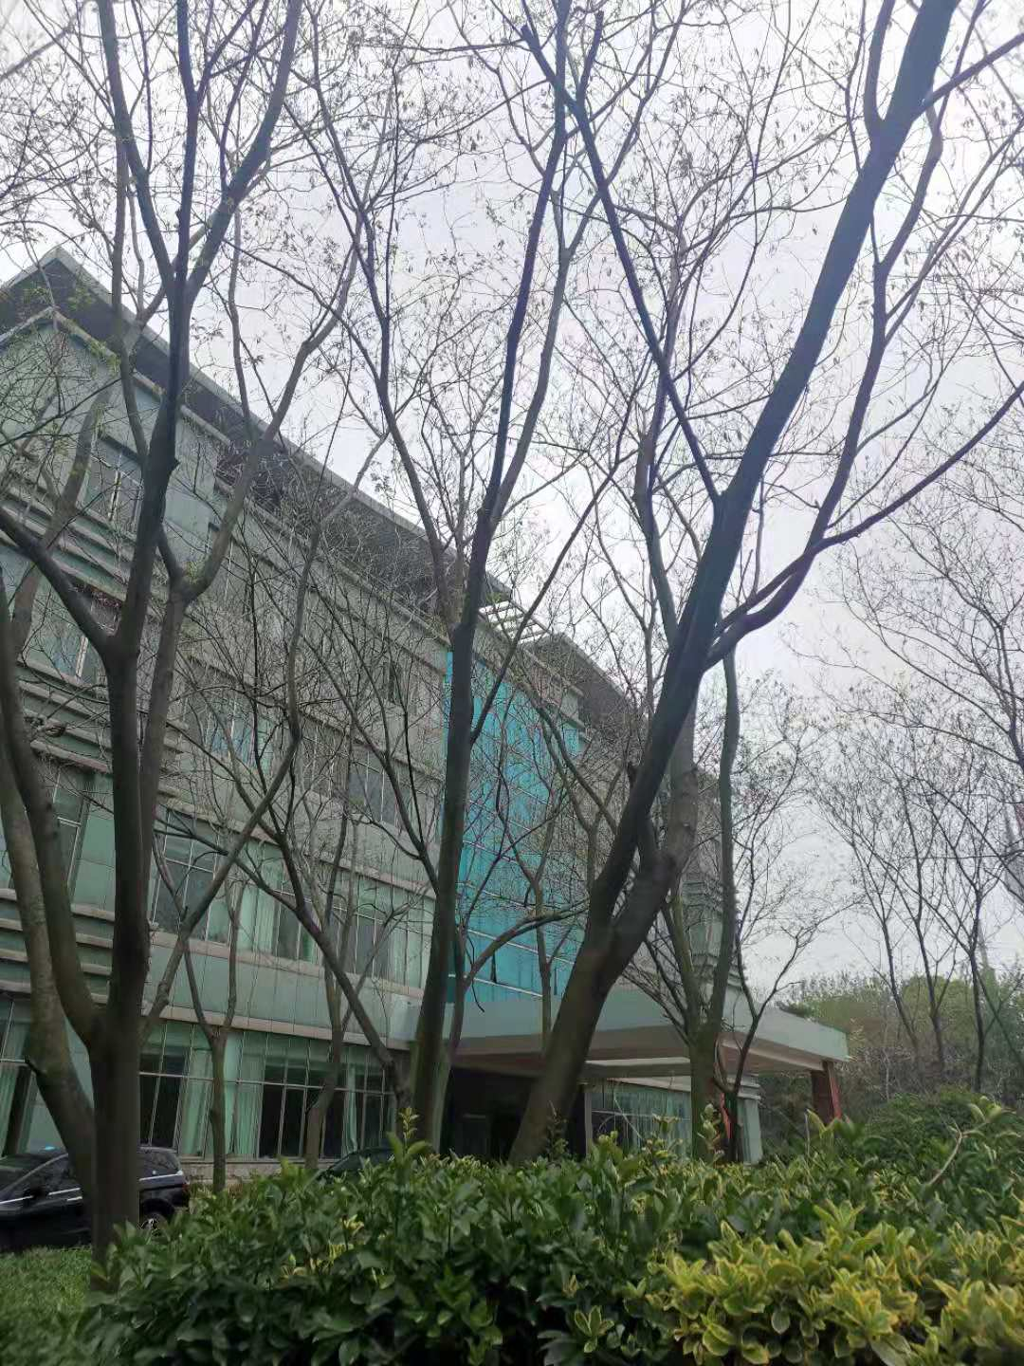

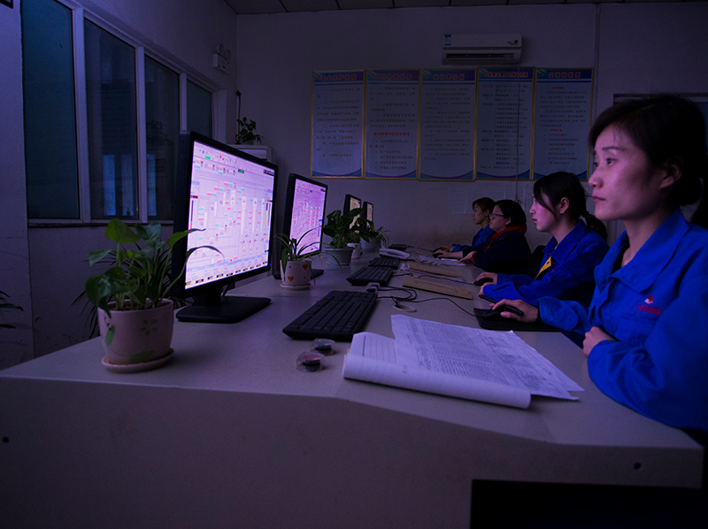
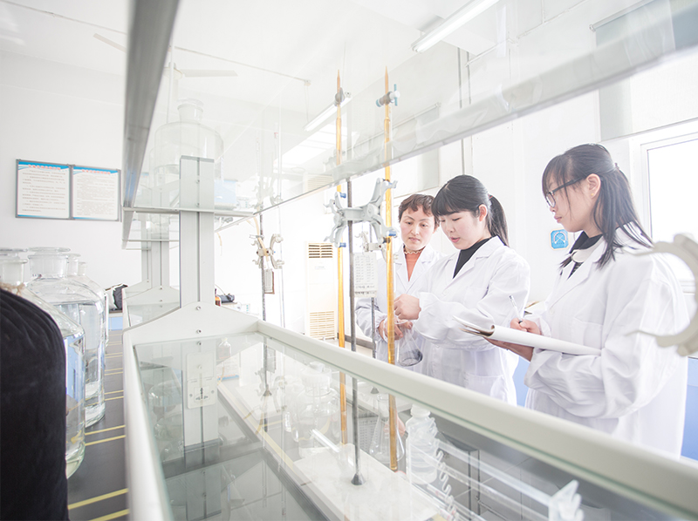
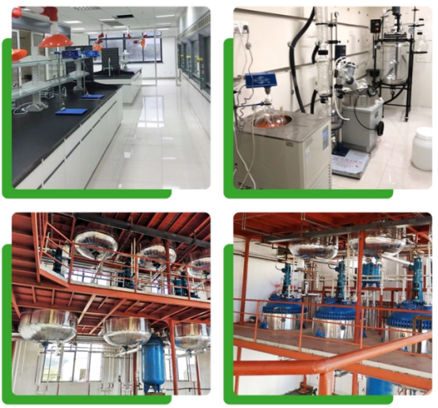
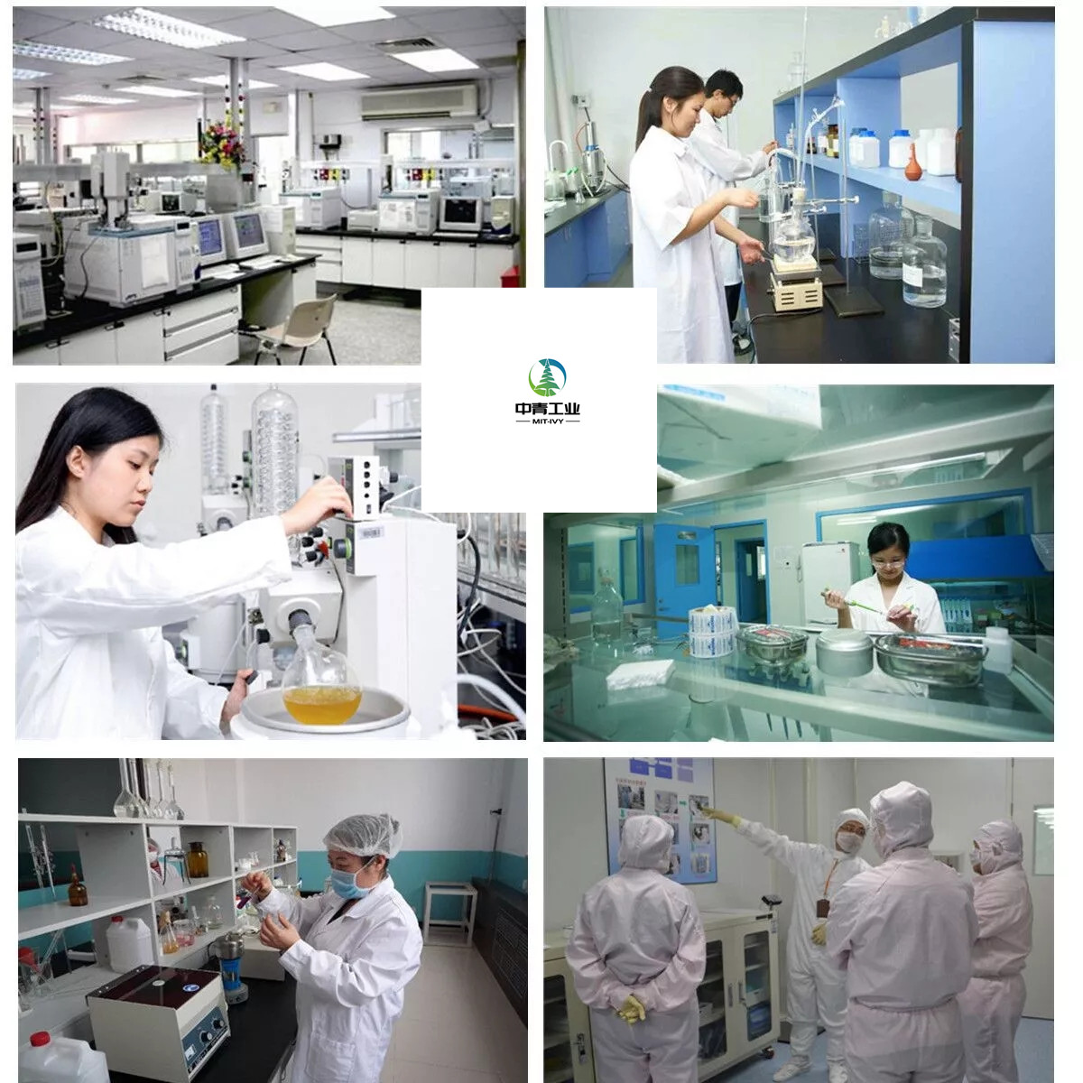
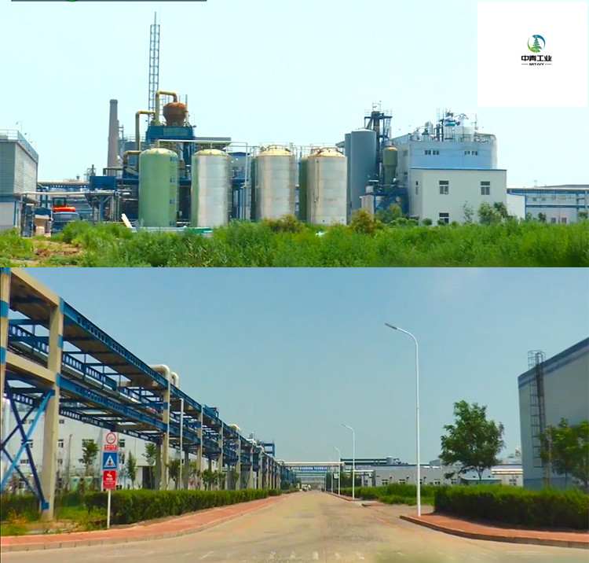
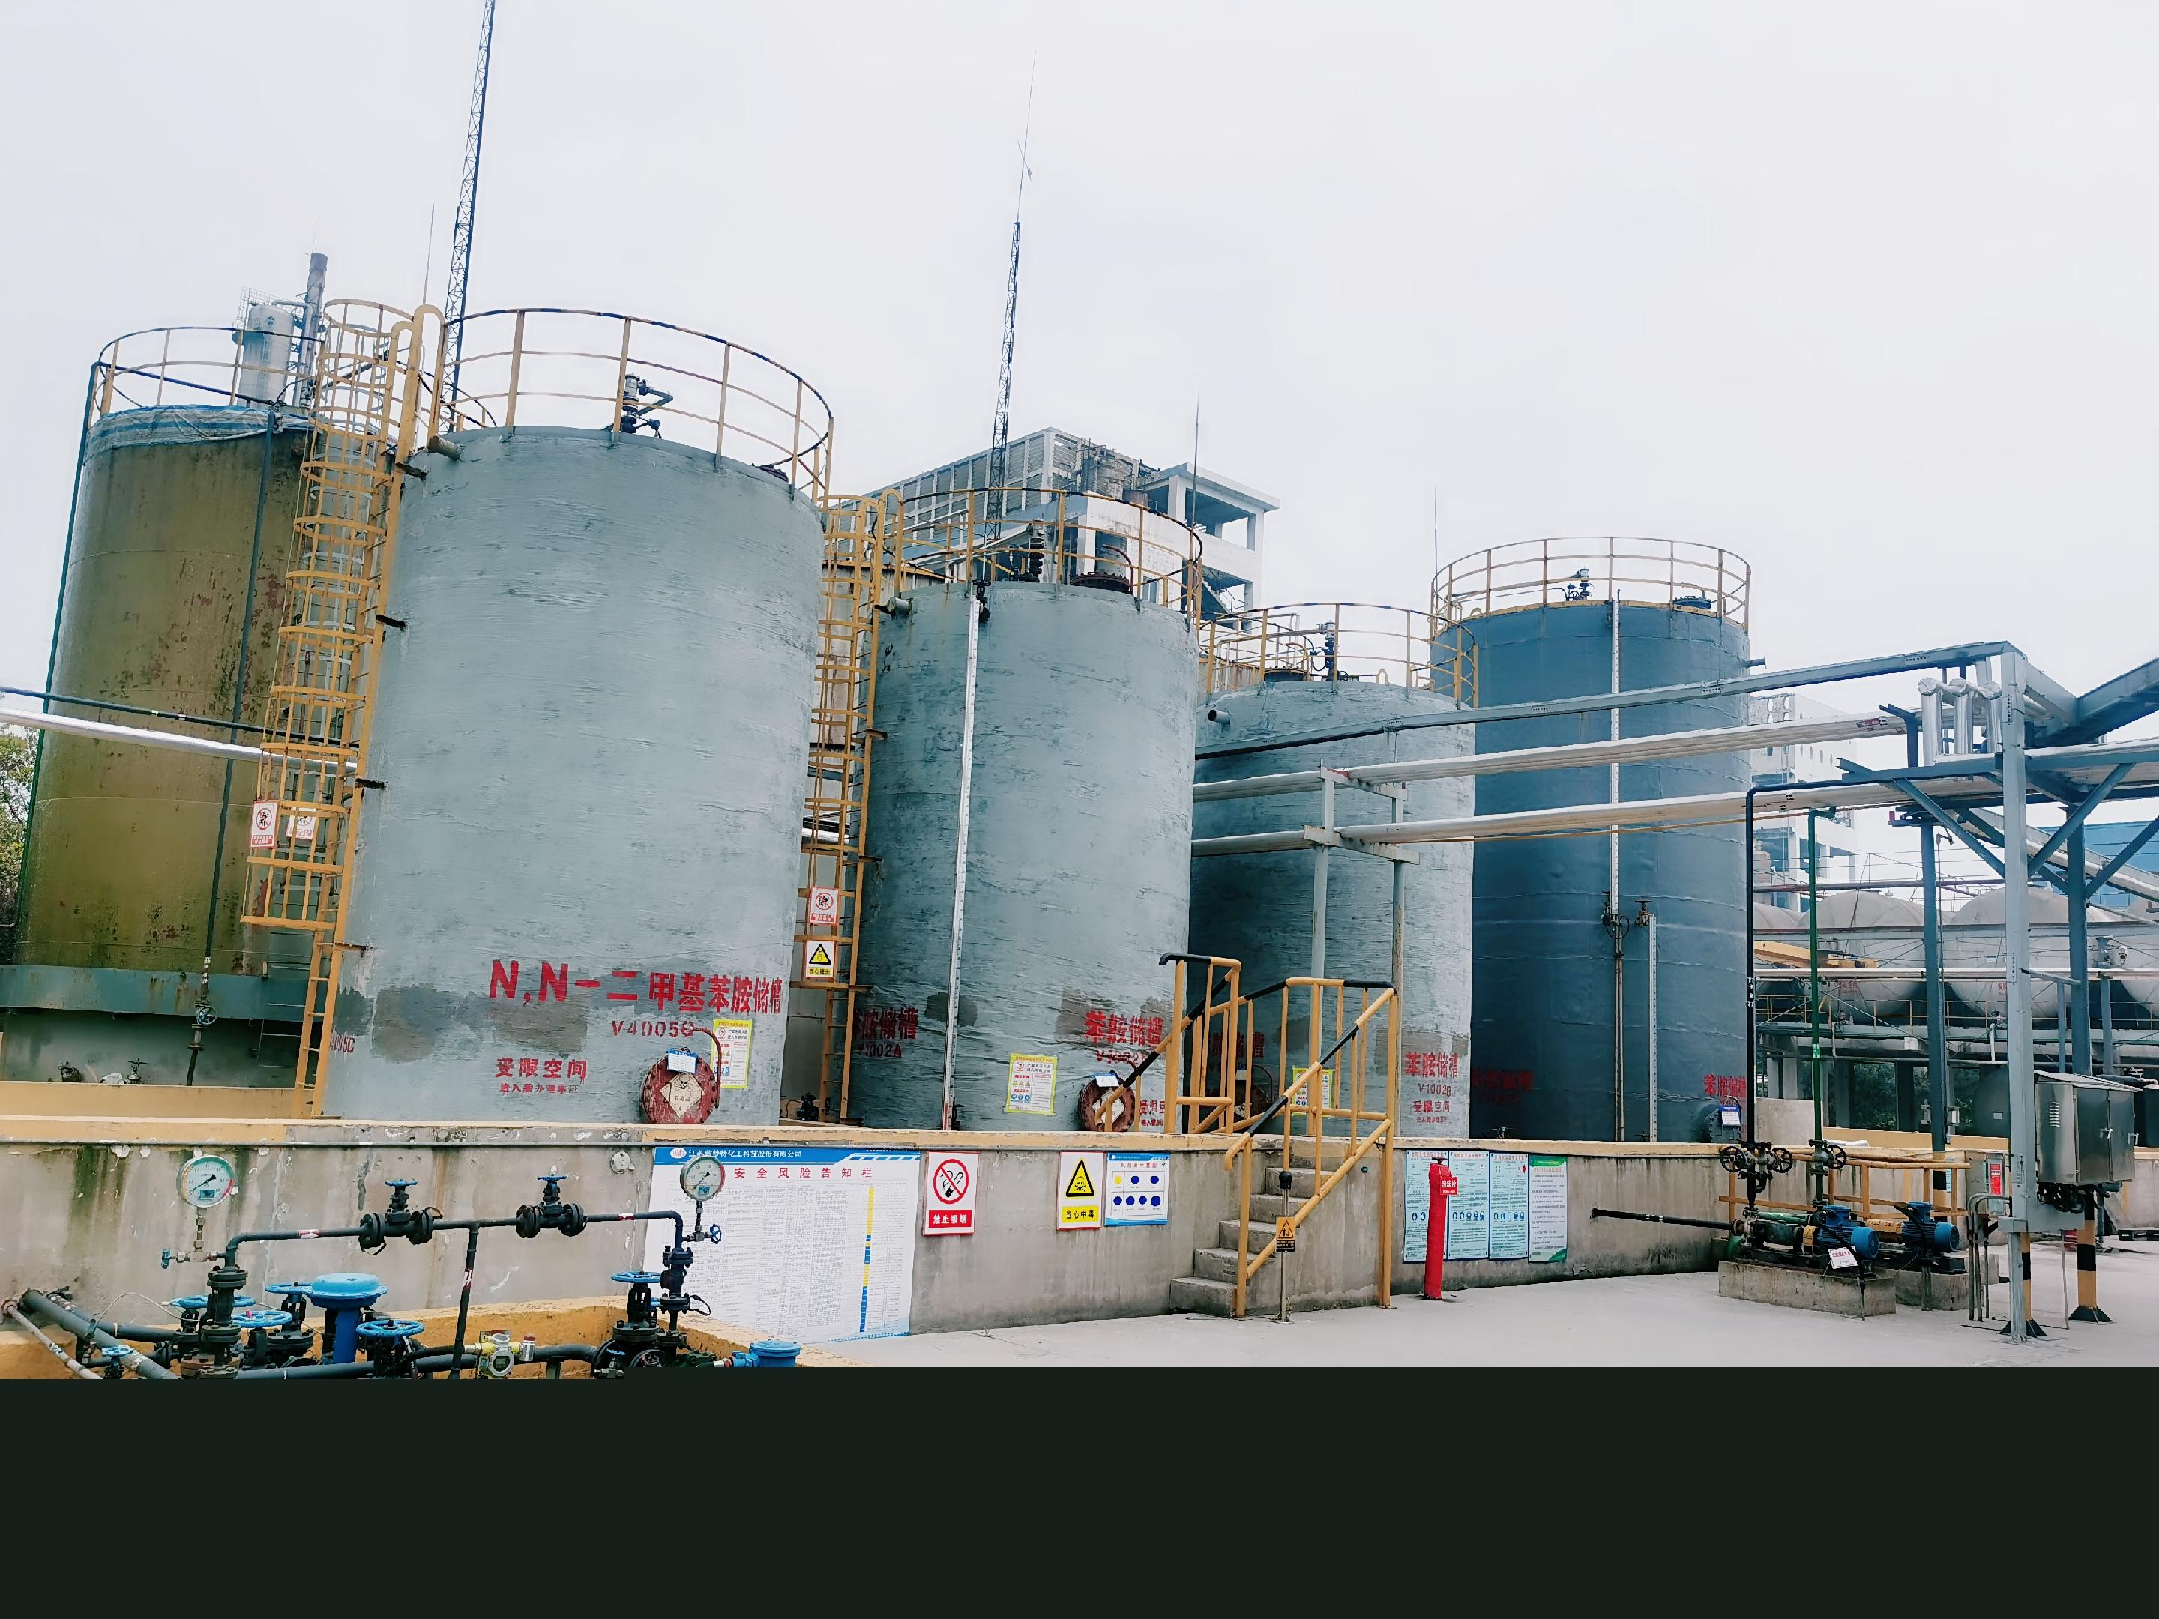
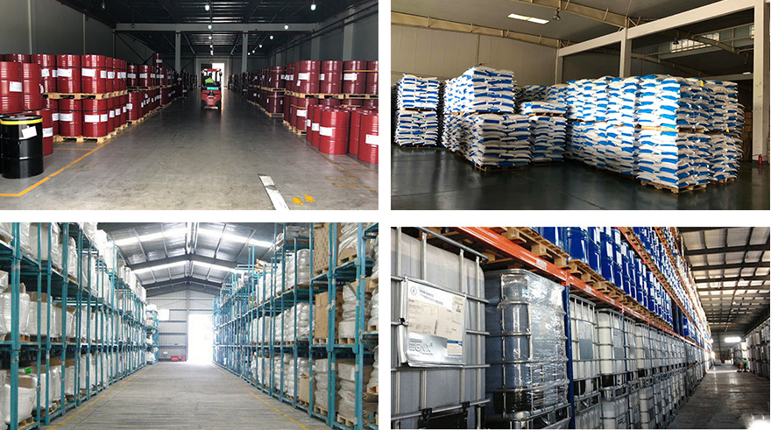
OFFICE
LABORATORY
FACTORY AND WAREHOUSE

Slide 7
02 Product Service

Slide 8
Dimethyl Series
Diethyl Series
Fine Chemicals
OUR
PRODUCT
Dyestuff
Mainly deal with 36 chemical products.
18 advantage products.

Slide 9
1) Beta naphthol 135-19-3
2) Bon acid 92-70-6
3) 2,5-Dichlorotoluene 19398-61-9
4) 2,3-Dichlorobenzaldehyde 6334-18-5
5) 2',4'-Dichloroacetophenone 2234-16-4
6) 2，4-dichlorotoluene 95-73-8
7) 2,4-Dichlorobenzyl alcohol 1777-82-8
8) 3,4'-Dichlorodiphenyl ether 6842-62-2
9) 1,3-Dichlorobenzene MDCB 541-73-1
10) 1-[2-Chloro-4-(4-chlorophenoxy)phenyl]ethan-1-one 119851-28-4
11) p-Toluidine PT 106-49-0
12) o-Toluidine OT 95-53-4
13) m-Toluidine MT 108-44-1
14) o-Phenylenediamine 95-54-5
15) m-Phenylenediamine MPDA 108-45-2
16) 4-Dimethylaminobenzaldehyde 100-10-7
17) Auramine O 2465-27-2
18) Crystal violet lactone CVL 1552-42-7
19) Methyl violet 8004-87-3
20) Basic Green 4 14426-28-9
21) N,N-Dihydroxyethylaniline PDEA 120-07-0
22) N-Ethyl-m-toluidine 102-27-2
23) 3-Methyl-N,N-diethyl aniline 91-67-8
24) 3-(N-ethylanilino)propiononitrile 148-87-8
25) N-Ethyl-N-hydroxyethylaniline 92-50-2
26) N-ethyl-N-phenylbenzenemethanamine 92-59-1
27) N-2-cyanoethyl-N-ethyl-m-toluidine 148-69-6
28) N-Benzyl-N-ethyl-m-toluidine 119-94-8
29) N,N-Diethyl aniline 91-66-7
30) N-Ethyl-o-toluidine 94-68-8
31) N-Ethylaniline 103-69-5
32) N,N-Dimethylaniline DMA 121-69-7
33) N-Methylaniline 100-61-8
34) 2-(N-methylanilino)ethanol 93-90-3
35) N,N-Dimethyl-p-toluidine 99-97-8
36) N,N-Dimethyl-o-toluidine 609-72-3

Slide 10
1) Beta naphthol 135-19-3
2) Auramine O 2465-27-2
3) Crystal violet lactone CVL 1552-42-7
4) o-Phenylenediamine 95-54-5
5) o-Toluidine OT 95-53-4
6) 3-Methyl-N,N-diethyl aniline 91-67-8
7) N,N-Diethyl aniline 91-66-7
8) N-Ethylaniline 103-69-5
9) N-Ethyl-o-toluidine 94-68-8
10) N,N-Dimethylaniline DMA 121-69-7
11) N,N-Dimethyl-p-toluidine DMPT 99-97-8
12) N,N-Dimethyl-o-toluidine DMOT 609-72-3
13) 2,3-Dichlorobenzaldehyde 6334-18-5
14) 2',4'-Dichloroacetophenone 2234-16-4
15) 2,4-Dichlorobenzyl alcohol 1777-82-8
16) 3,4'-Dichlorodiphenyl ether 6842-62-2
17) 2-chloro-4-(4-chlorophenoxy)acetophenone 119851-28-4
18) 2，4-dichlorotoluene 95-73-8

Slide 11
1)Beta naphthol
MF
CAS
C10H8O
135-19-3
APPLICATION
APPEARANCE
Used in the preparation of Tobias acid, J acid, 2.3-acid, and used in the preparation of anti-aging agent D, anti-aging agent DNP and its anti-aging agent, organic pigment and fungicide.
White shiny crushed powder or white powder.
Item | Specifications
Purity (Beta Naphthol as content) | ≥99%
1-naphthol | ≤0.30%
Naphthalene | ≤0.40%
Moisture | ≤0.10%

Slide 12
2)Auramine O
CAS
MF
2465-27-2
C17H22N3Cl
APPEARANCE
APPLICATION
Yellow powder.
Mainly used for dyeing fiber acetate and cotton fabrics, and also used for coloring paper, leather, paint, etc.
Item | Specifications
Purity | ≥99.5%
Strength | 200% 210%
Melting point | >250 °C (dec.)(lit.)
PH | 6-7 (10g/l, H2O, 20℃)

Slide 13
3)Crystal violet lactone CVL
CAS
MF
1552-42-7
C26H29N3O2
APPEARANCE
APPLICATION
White powder
It is an important functional dye for the production of pressure-sensitive materials.
Item | Specifications
Assay | ≥99.0%
Melting point | 180-183°C
Boiling point | 534.12°C (rough estimate)
Density | 1.1424 (rough estimate)
Refractive index | 1.7120 (estimate)
Water Solubility | <0.1 g/100 mL at 22.5 ºC

Slide 14
4)o-Phenylenediamine
MF
CAS
C6H8N2
95-54-5
APPEARANCE
APPLICATION
Colorless monoclinic crystal.
As pesticide intermediates, dye intermediates.
Item | Specifications
O-phenylenediamine's content | ≥99.0%
Content of o-chloroaniline | ≤1.0%
Content of o-nitroaniline | ≤0.1%
Purity | ≥99%

Slide 15
5)o-Toluidine OT
CAS
MF
95-53-4
C7H9N
APPEARANCE
APPLICATION
Light yellow flammable liquid, it turns reddish brown when exposed to air and sunlight.
Used as dye, pesticide, medicine and organic synthesis intermediate.
Item | Specifications
Assay | 99% min
Low boiling substance | 0.10% max
Aniline | 0.2% max
p-Toluidine | 0.1% max
m-Toluidine | 0.4% max
Water | 0.3% max
High boiling point substances | 0.3% max

Slide 16
6)3-Methyl-N,N-diethyl aniline
CAS
MF
91-67-8
C11H17N
APPLICATION
APPEARANCE
Dye intermediates.
It is used to produce weak acid brilliant blue BA and other dyes.
It can also be used to synthesize positive film CD-2 for color development.
Light yellow liquid.
Item | Specifications
Assay | ≥99%
Moisture | <0.04%
Heavy Metals | <0.002%
Boiling point | 97 °C (17 mmHg)

Slide 17
7)N,N-Diethyl aniline
MF
CAS
(C2H5)2NC6H5
91-66-7
APPEARANCE
APPLICATION
Light yellow liquid.
Used in dye intermediates, latex accelerators, pharmaceuticals, pesticides, etc.
Item | Specifications
Assay | ≥99%
Molecular weight | 149.23
Melting point | -38ºC
Boiling point | 215-217ºC at 760 mmHg
Relative density | 0.938g/cm3

Slide 18
8)N-Ethylaniline
MF
CAS
C8H12N
103-69-5
APPEARANCE
APPLICATION
White shiny crushed powder or white powder.
Used as pesticide and dye intermediates, rubber accelerators, etc.
Item | Specifications
Assay | ≥99%
N-ethylaniline | ≥ 99.00%
Aniline | ≤ 0.40%
N,N-diethylaniline | ≤0.40 %
Other & moisture | ≤0.20 %

Slide 19
9)N-Ethyl-o-toluidine
MF
CAS
C9H13N
94-68-8
APPEARANCE
APPLICATION
Colorless transparent liquid.
Used in dyes, medicine and other organic synthesis
A stain used for proteomics research.
Item | Specifications
Assay | ≥99.5%
MW | 135.21
Melting point | -6.87°C
Boiling point | 218 °C
Density | 0.938 g/mL at 25 °C

Slide 20
10)N,N-Dimethylaniline DMA
CAS
MF
121-69-7
C8H11N
APPEARANCE
APPLICATION
Colorless transparent liquid.
One of the basic raw materials for the production of basic dyes (triphenylmethane dyes, etc.) and basic dyes. The main varieties are basic bright yellow, basic violet 5BN, basic green, basic lake blue, brilliant red 5GN, brilliant Blue etc.
N,N-dimethylaniline is used in the pharmaceutical industry to manufacture cephalosporin V, sulfa-b-methoxine, sulfa-dimethoxine, fluosporine, etc., and in the perfume industry to manufacture vanillin Wait.
Item | Specifications
Assay | ≥99.5%
N,N-dimethylaniline | ≥99.00%
Aniline | ≤0.5%
N-methylaniline | ≤0.8%
Other & moisture | ≤0.6%%

Slide 21
11)N,N-Dimethyl-p-toluidine DMPT
CAS
MF
99-97-8
C9H13N
APPLICATION
APPEARANCE
Light Yellow Liquid.
Used to make self-curing dental tray water; glue accelerator, marble glue; production of anchoring agent.
Used in dyes, medicine and other organic synthesis.
Item | Specifications
Identification (By GC) | Conform to the standard
N,N-dimethyl-p-toluidine assay | ≥99.00%
p-toluidine assay | ≤0.05%
N-methyl-p-toluidine assay | 0.70%
Another assay | 0.30%

Slide 22
12)N,N-Dimethyl-o-toluidine DMOT
CAS
MF
609-72-3
CH3C6H4N(CH3)2
APPEARANCE
APPLICATION
Pale yellow oily liquid.
Used in organic synthesis
Used as an accelerator
It can be used as a starting reagent for the synthesis of rosexanthin.
Item | Specifications
Assay | ≥ 99%
p-Toluidine | 0.2%max
N-METHYL-P-TOLUIDINE | 0.4%max
Moisture | 0.4%max

Slide 23
13)2,3-Dichlorobenzaldehyde
CAS
MF
6334-18-5
C7H4Cl2O
APPLICATION
APPEARANCE
White crystal.
Used as an intermediate for the drug felodipine and as a dye intermediate.
Item | Specifications
Assay | ≥ 99%
Loss on drying | ≤0.5%
Ignition residue | ≤0.5%
Boiling Point | 242.9 °C at 760 mmHg

Slide 24
14)2',4'-Dichloroacetophenone
CAS
MF
2234-16-4
C8H6Cl2O
APPEARANCE
APPLICATION
White crystalline solid.
Used as a pharmaceutical intermediate for the synthesis of ketoconazole drugs.
Item | Specifications
Assay | ≥99%
Water | 0.50%max
Single impurity | 0.20% max
Total Impurity | 0.50%
Melting Point | 32.0-34Deg.Cent

Slide 25
15)2,4-Dichlorobenzyl alcohol
CAS
MF
1777-82-8
C7H6Cl2O
APPLICATION
APPEARANCE
White Powder.
Used as pharmaceutical intermediate.
Item | Specifications
Assay | ≥99%
Melting point | 57-60 C (lit.)
2,5-Dichlorobenzyl alcohol | ≤0.2%
Solubility | Clear solution
Sulfated ash | ≤0.5%

Slide 26
16)3,4'-Dichlorodiphenyl ether
CAS
MF
6842-62-2
C14H10Cl2O2
APPEARANCE
APPLICATION
Liquid
It is an intermediate for the preparation of the fungicide difenoconazole.
Widely used as pharmaceutical and pesticide intermediates.
Item | Specifications
Assay | ≥99.0%
Moisture | <0.04%
Heavy Metals | <0.002%
Boiling point | 314.9°C at 760 mmHg

Slide 27
17)2-chloro-4-
(4-chlorophenoxy)acetophenone
CAS
MF
119851-28-4
C12H8Cl2O
APPLICATION
APPEARANCE
White powder
Used as a pesticide and pharmaceutical intermediate, it is an essential intermediate for the synthesis of oxaconazole.
Item | Specifications
Assay | ≥99.0%
Loss on drying | NMT0.5%
Residue on ignition | NMT0.1%
Heavy metals | NMT 10ppm

Slide 28
18)2，4-dichlorotoluene
MF
CAS
C7H6Cl2
95-73-8
APPLICATION
APPEARANCE
1) Used as intermediates of pesticides, dyes, and pharmaceuticals, used in the production of 2,4-dichlorobenzaldehyde, drugs such as adipine, buprofen, etc.
2) 2,4-Dichlorotoluene is an intermediate of the bactericide diniconazole and benzylchlorotriazole alcohol, and it is also the raw material for the preparation of 2,4-dichlorobenzaldehyde Chemicalbook.
3) Organic synthetic raw materials, used in the pharmaceutical industry for the production of antimalarial drugs, Ardepine, and the synthesis of buprofen. Used in pesticide intermediates to manufacture 2,4-dichlorobenzyl chloride, 2,4-dichlorobenzoyl chloride, and 2,4-dichlorobenzoic acid.
White powder
Item | Specifications
Assay | ≥99.0%
Melting point | -14 °C
Boiling point | 200 °C(lit.)
Relative density | 1.246 g/mL at 25 °C(lit.)

Slide 29
03 Business Development

Slide 30
Industry leader strong
As the industry benchmark for supply chain services in the field of chemical products in China, it is fully equipped with a set of precise operation system and has established long-term stable and reliable cooperative relations with many well-known chemical companies and large chemical plants.
Quality
High-quality products, high-quality prices
The company pays attention to the process control of product quality, insists on only making "genuine products"; insists on the concept of mutual progress with customers and win-win cooperation. Providing market advantage prices, has won an excellent reputation among many customers.
Price
Professional team, service first
We have rich experience in international trade, professionals in the chemical industry, and a professional sales team with "one-to-one" refined service. According to your needs, we will provide you with accurate quotation and consulting services in a timely manner, and fully check your purchases.
Service
Efficient logistics and lightning delivery
The company has its own fleet and has signed a number of well-known logistics companies.Provide you with fast, safe and accurate transportation.
Transport
Complete variety and sufficient inventory
The company currently operates more than 100 kinds of chemical products, and has barreled, bagged warehouses and liquid storage tanks in Nantong, Shanghai, Lianyungang, Changzhou, Xuzhou, and Inner Mongolia.
Large storage capacity and stable supply.
Spot

Slide 31
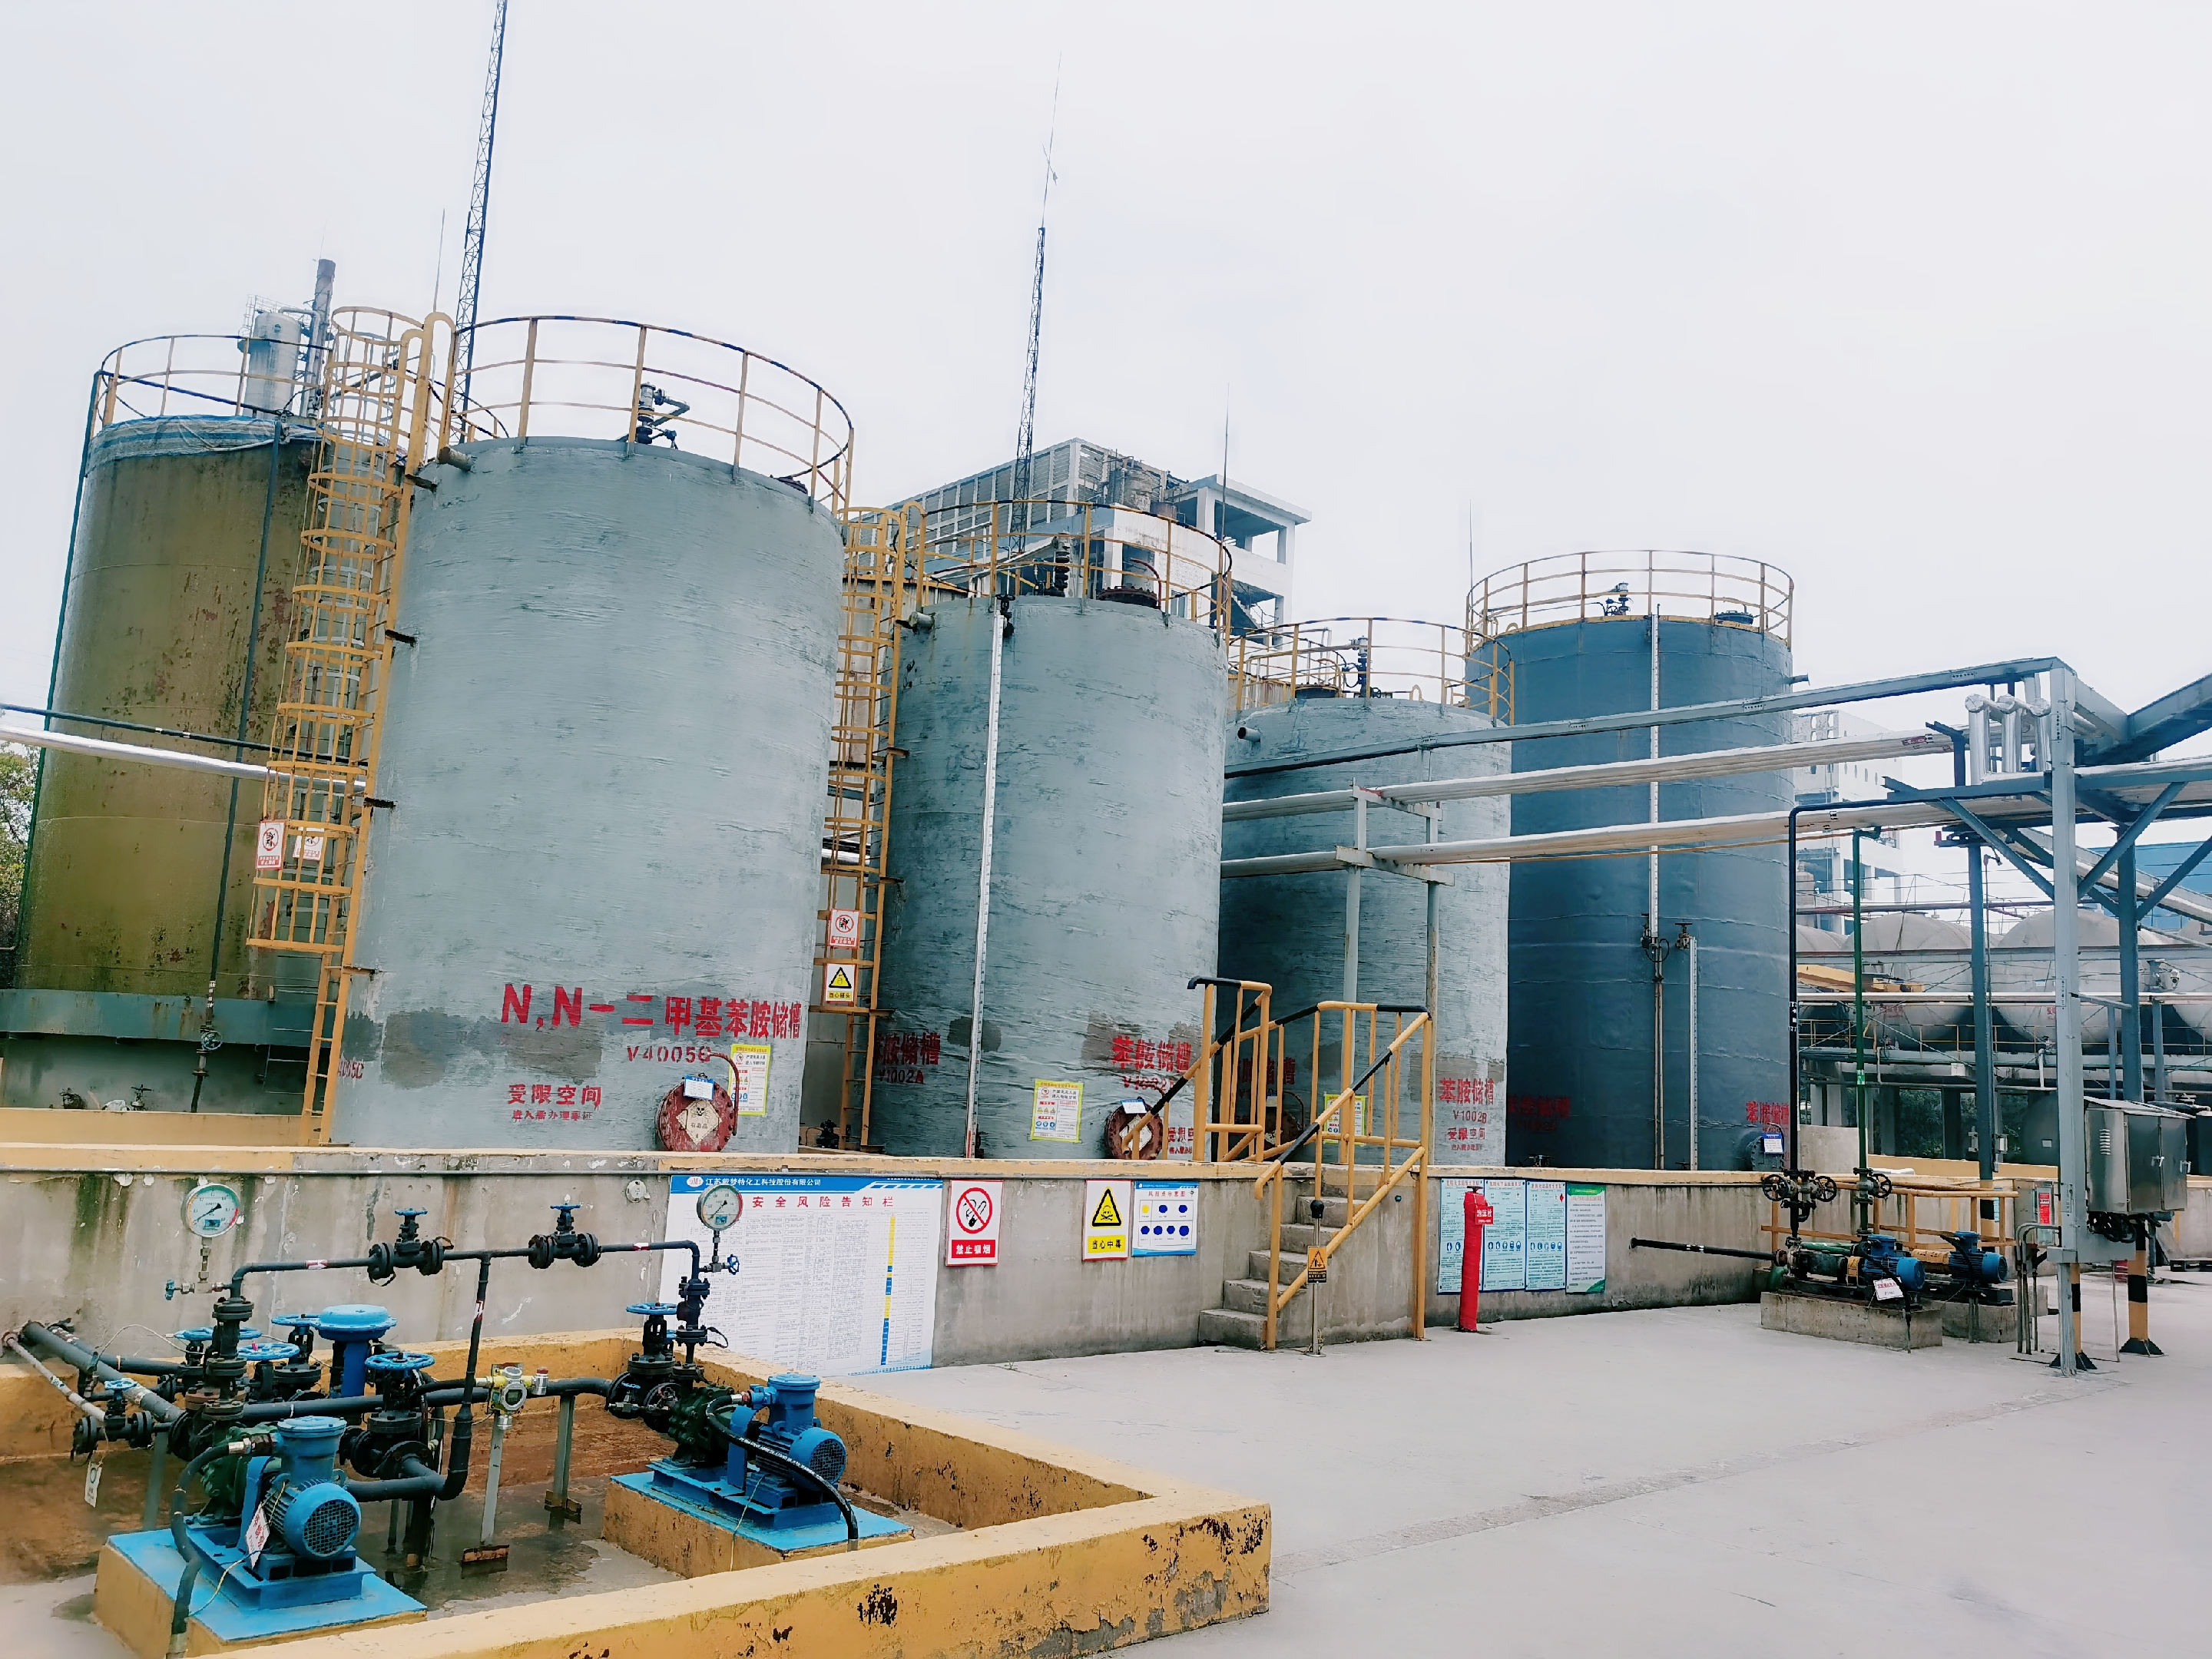
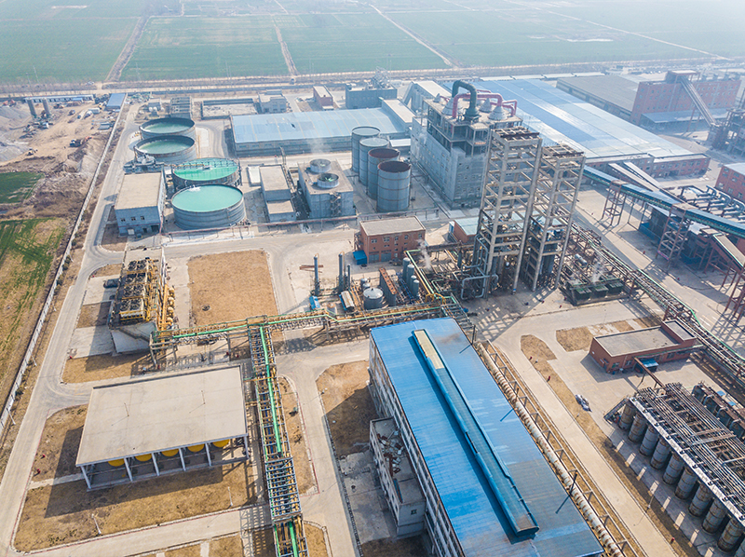
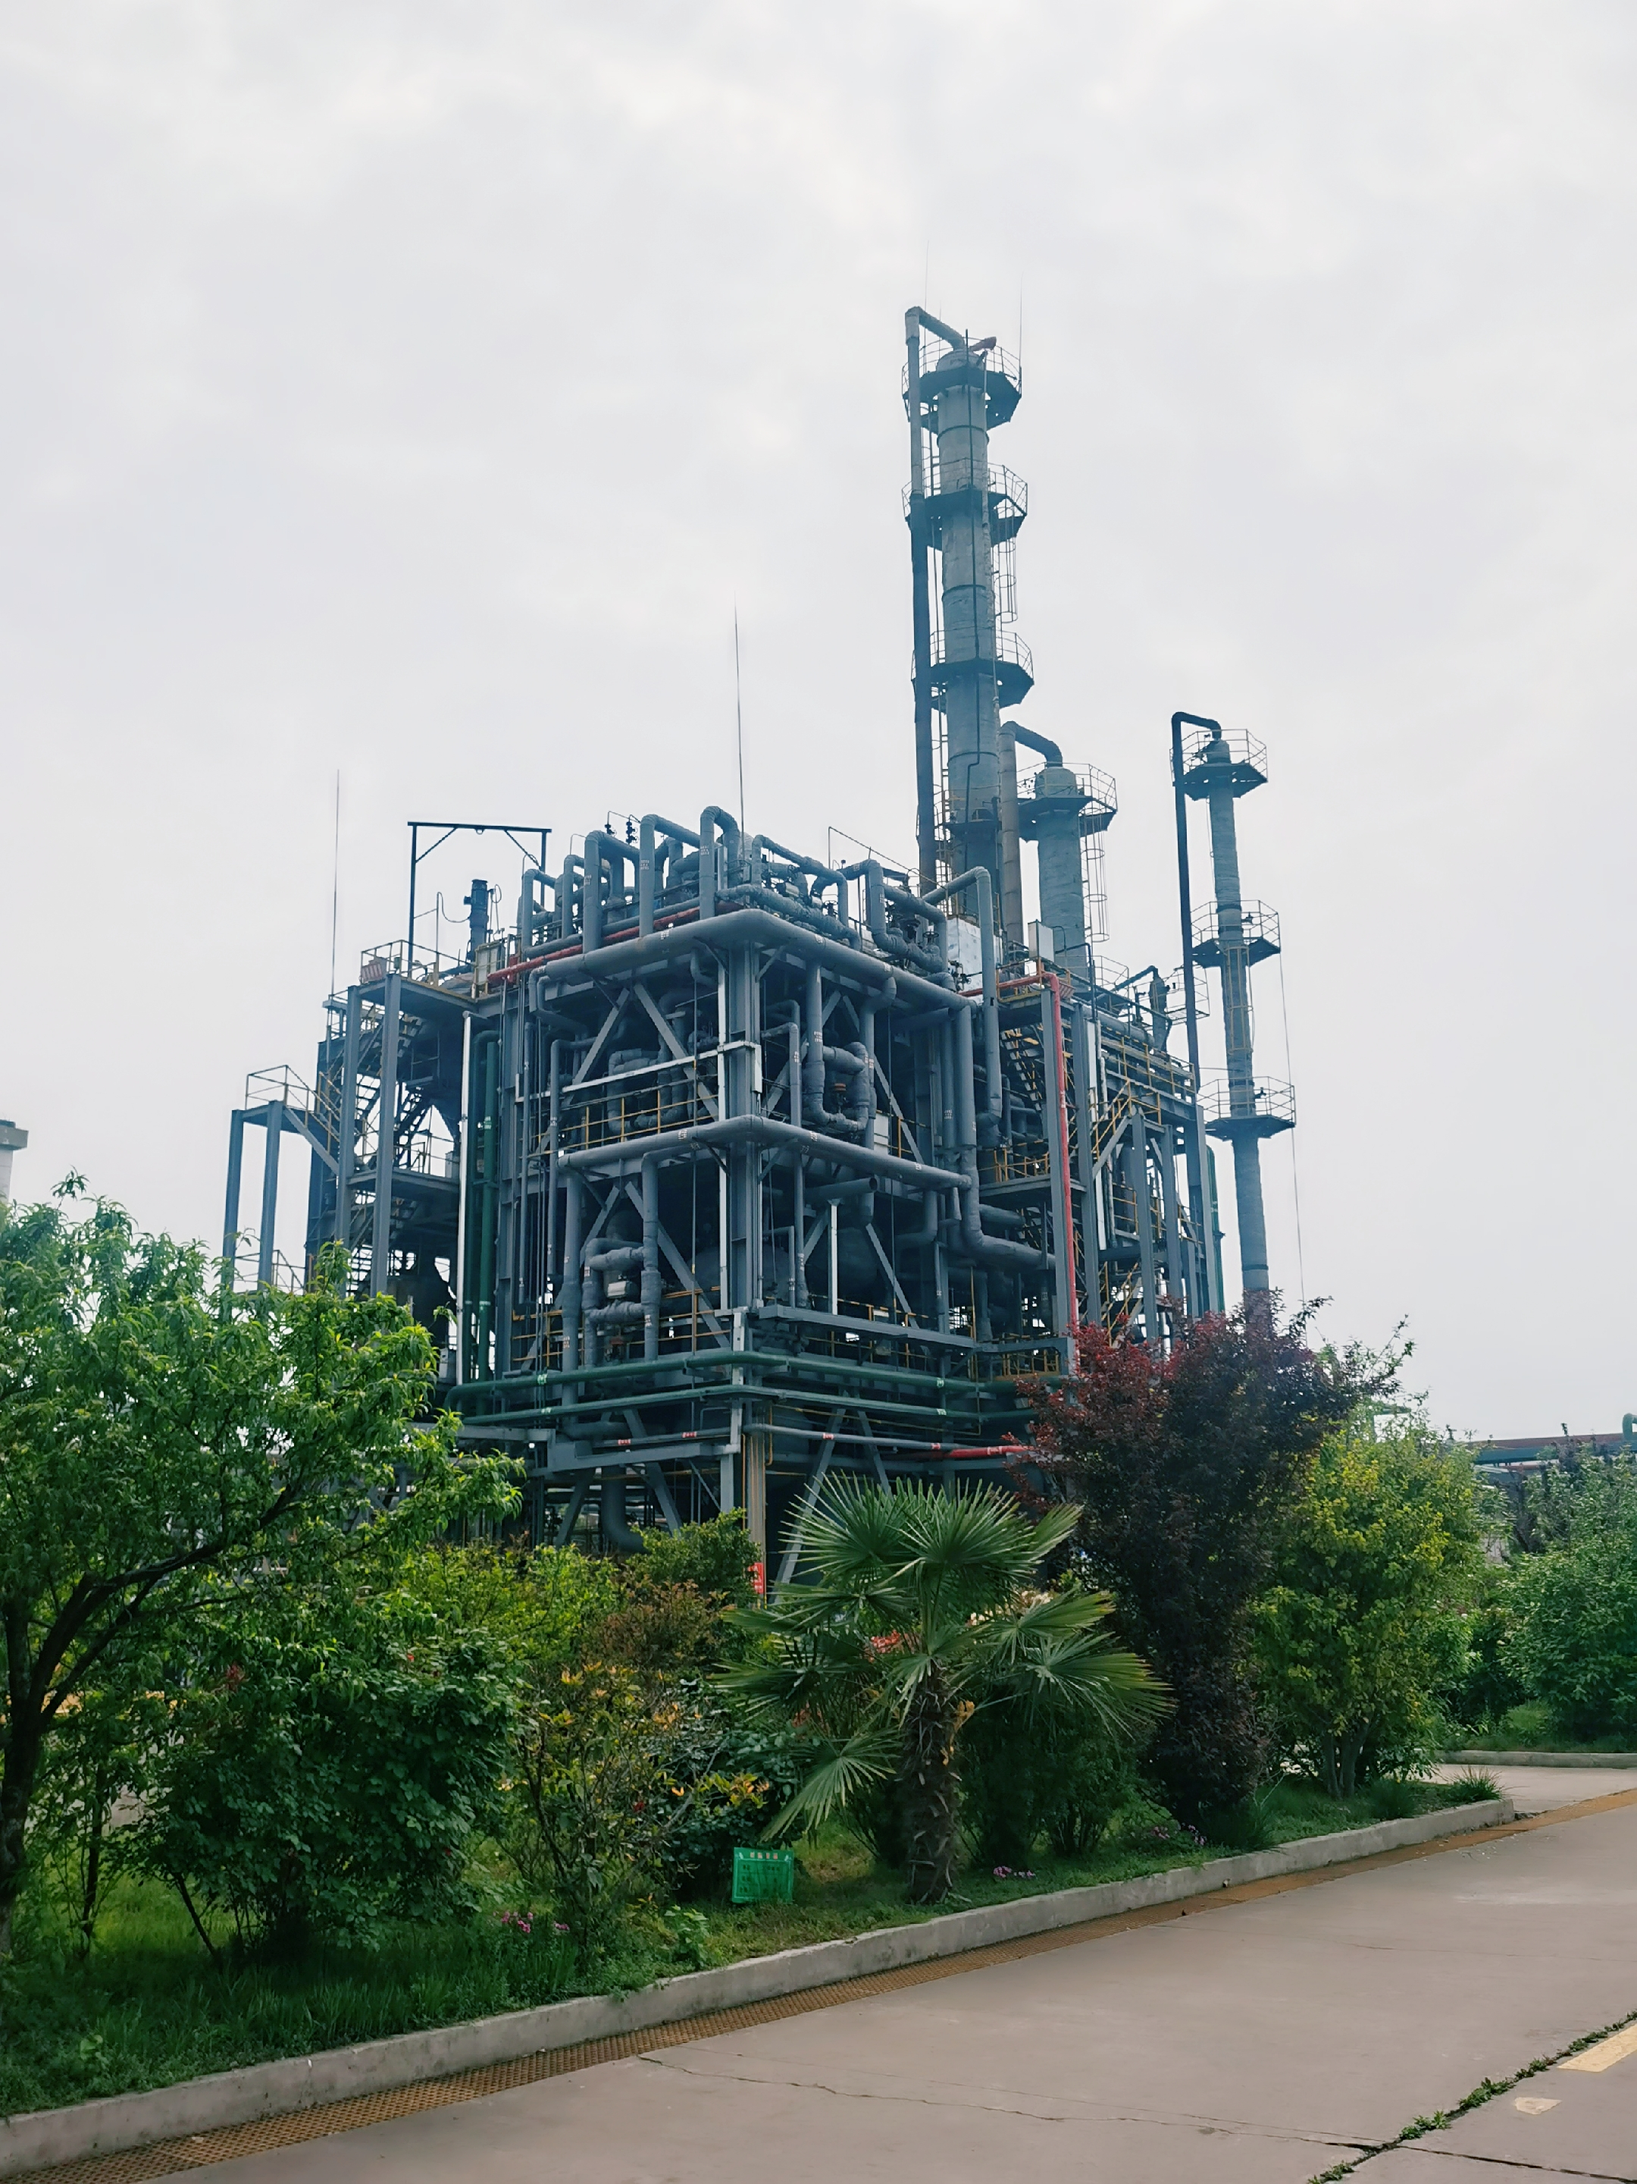
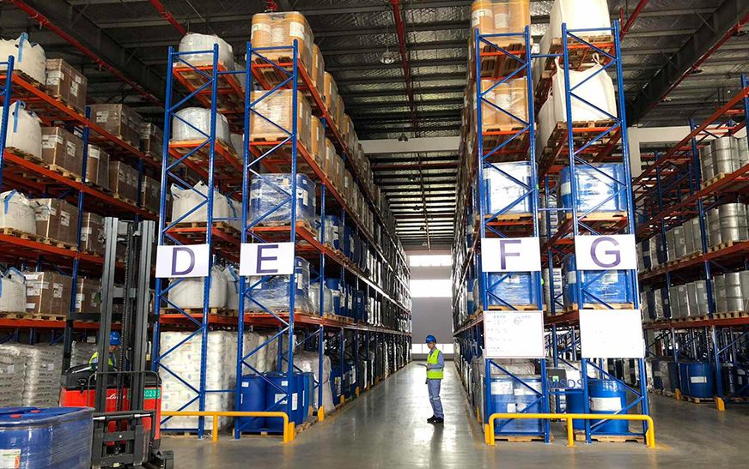
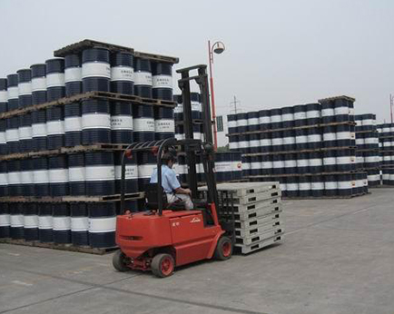
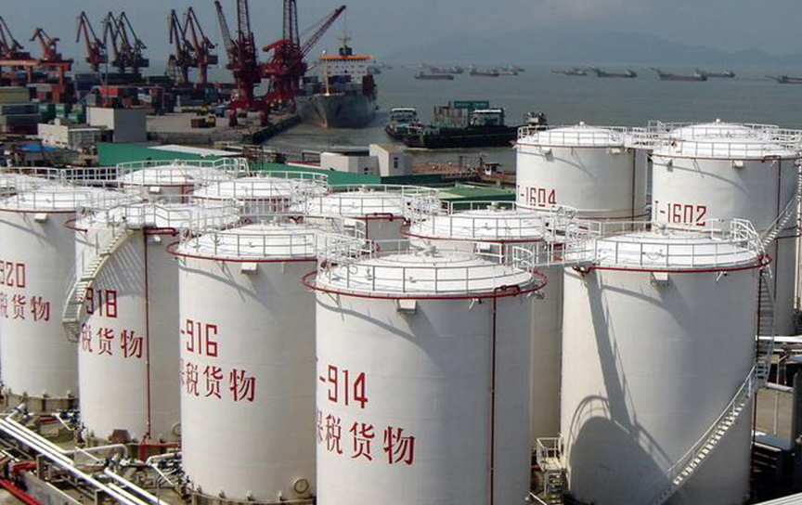

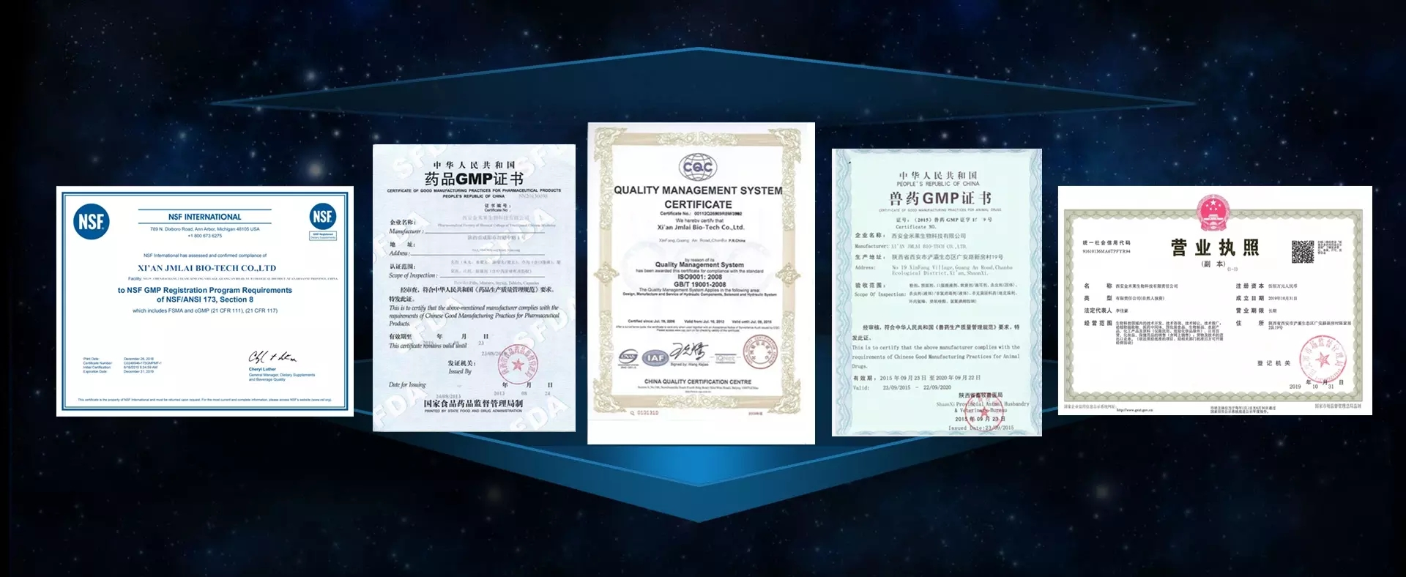
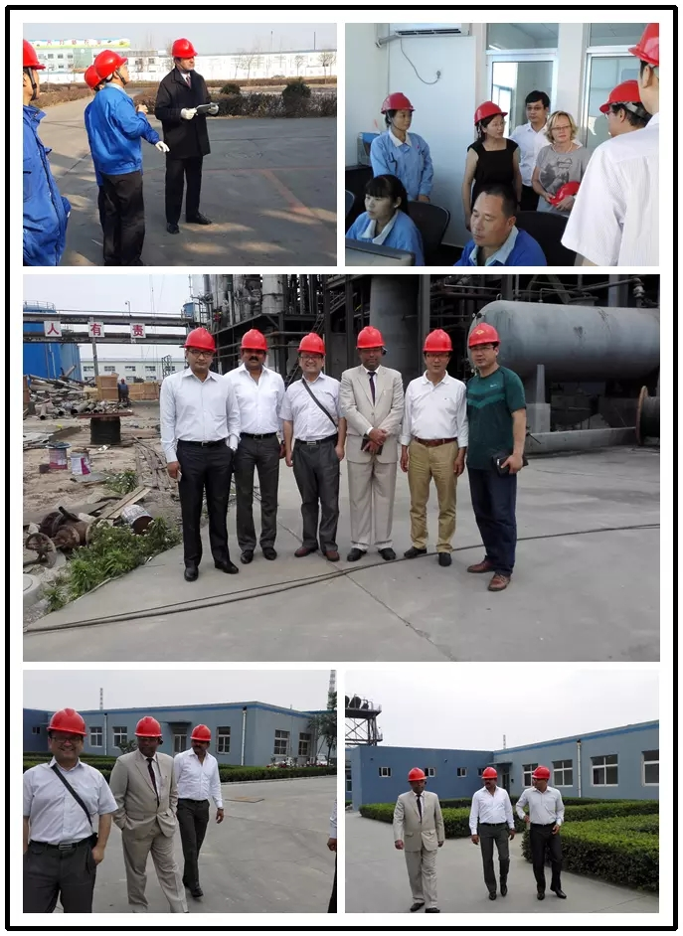
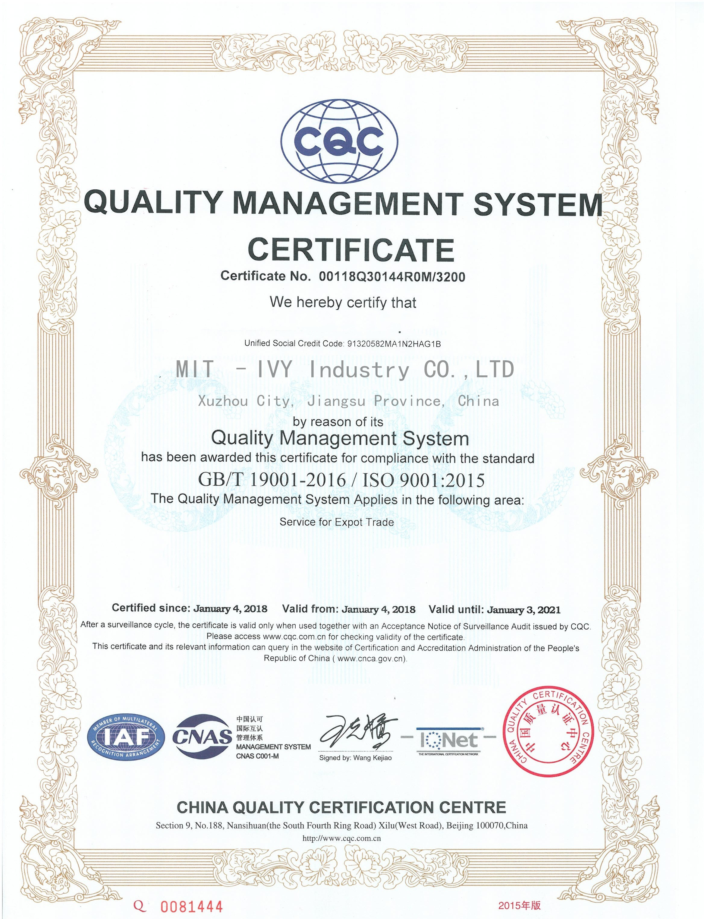

Slide 32
04 Contact Us

Slide 33
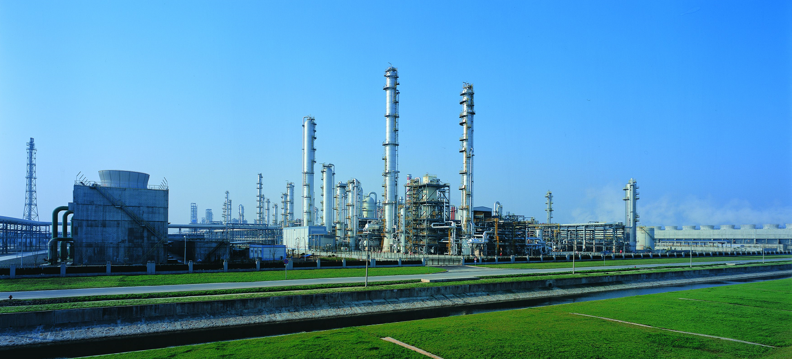
MIT-IVY INDUSTRY Co., Ltd.
Phone/WhatsApp: +86-13805212761
Email:info@mit-ivy.com
Athena Fan
Phone/WhatsApp: +86-18136360528
Email:gm@mit-ivy.com
Joyce Zhang
Phone/WhatsApp: +86-5705216150
Email:kelley@mit-ivy.com
Kelley Qi
👉MIT-IVY INDUSTRY Co., Ltd. Fine Chemicals Source Manufacturing Plant👈
http://www.mit-ivy.com

Slide 34



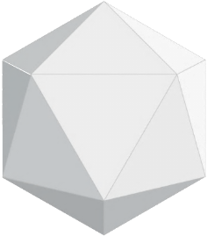
中青工业
MIT -IVY Industry Co., Ltd

