Slide 1




Website: http://www.mit-ivy.com
Fine chemicals
specialty chemicals
organic intermediates
Resin curing agent
MIT -IVY INDUSTRY Co.,Ltd
MIT -IVY INDUSTRY Co.,Ltd
Phone/whatsapp/Telegram+ 86-13805212761
Email: info@mit-ivy.com
Adress:Economy and technology in Changde, Hunan Province No.42, Minjian Road

Slide 2

目 录
CATALOG
01
02
03
04
公司介绍
公司团队
公司产品
发展规划
COMPANY
TEAM
PRODUCT
CUSTOMER

Slide 3
01
公司介绍
MIT-IVY INDUSTRY COMPANY

Slide 4
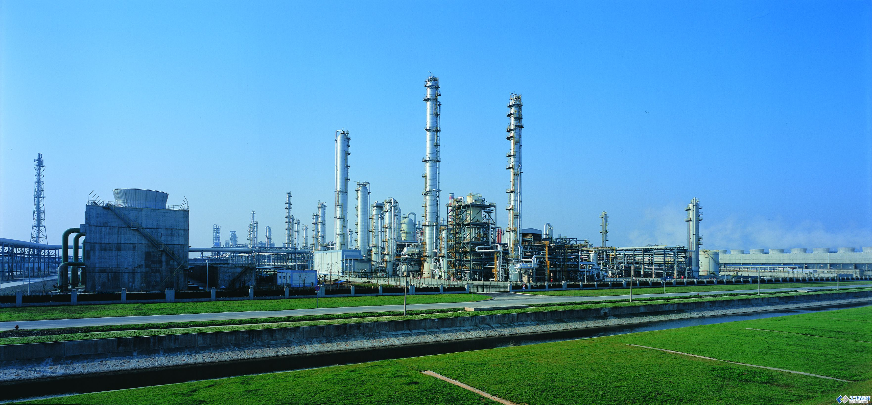
ABOUT COMPANY
MIT –IVY Industry supplier of Fine chemicals， N-alkylated aniline series products ，organic intermediates.& specialty chemicals ,Leading products N- methyl aniline series, N- ethyl aniline series annual output of tens of thousands of tons.
We provide with quality products, timely delivery, technology and best in-class services .
Our company with mature technology, reliable quality products in the domestic and foreign markets enjoy a certain reputation.
We know only by delivering you the solution and solving the problem, we can make our profit.
With excellent product quality, product consistency and strict safety and environmental protection controls, we have made our name throughout the world.MIT-IVY INDUSTRY has been working closely with many global chemical companies such as Archroma, BASF,Indulor Sun Chemical and etc.

Slide 5
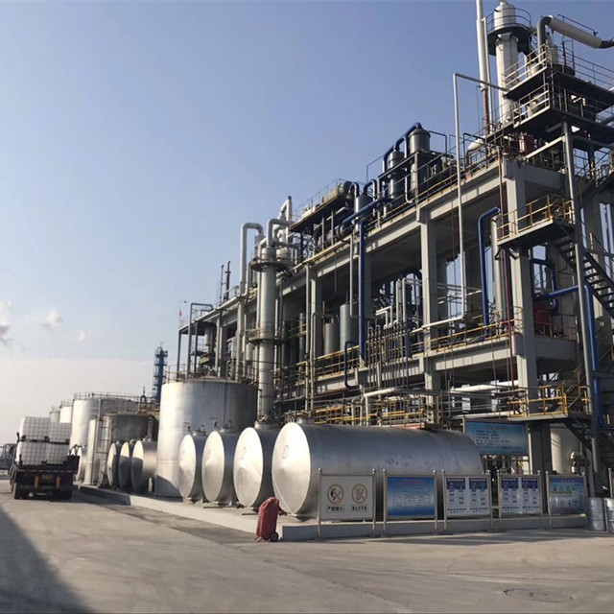
ABOUT FACTOURY
MIT -IVY Industry use advance d production technology and test methods to realize production, quality controlling to meet the standard. We have been approved by REACH CETIFICATION ,SGS, ISO9001, ISO140 01, GB/HS16949 and T28001.
Technology is the first productive force. It uses science and technology to create a brand, constantly adapts and meets the diverse needs of the market and customers, in order to realize the highest value of the company.
MIT -IVY Industry hold “Integrity as root, technology s foundation,quality superiority,and top service”to produce our goods in International standard,our main technology index all meet International standard. We always believe that technology is the first productive force to creat “first class “brand to make out company among the top in this line.
So we also set up its own laboratory, hired excellent scientific and technical management personnel, give priority to the development of science and technology, and strive to be the best in the industry.

Slide 6


MIT-IVY INDUSTRY FOCUS
The leaders pay more attention to the management of the strategic development, transformation and upgrading while playing to their strengths.There is management innovation in strategic, marketing,HR and financial management. Also, the company execute fine management on the manufacturing just aims to be the one which has great influence among the ones with same occupation and tries to be the example in standardized management in certain district.
With honesty and credit as our idea, with high-class technology, stable quality, nicer service, suitable price and brand promotion, MIT-IVY is looking forward to cooperating with all the friends, and going to the brightly future.
Professional
Faith
Development
Cooperation
Innovation

Slide 7
MIT –IVY INDUSTRY HIGHLIGHT
2008-2012
1996
1996-2000
2009
The spray drying device of Acid black 177 by the national ministry of science and technology as "national torch plan project" in Sept. 2009
The company was formally established in April 1996
2012
2012-2015
By 2012, Named as Harmonious Enterprise
2006
2002-2008
2017
By 2006 passed the SO9000, ISO14000 certification
2001
2017
2000-2002
By 2001 opening of ERP financial management software,standardizeo
financial management
In OCT 2017, the mass production for DMA began in jiangsu EAST IVY Fine Chenical Co..Ltd.

Slide 8


FAITH-BASED TECHNOLOGICAL INNOVATION
Management is the basis, Quality is the life Benefit is the fundmental, Market is the guide and Technology is the leader
Tenet
1
people-oriented, revitalizing the enerprise by science and technology, always to be the first and unceasingly transcends ourselives
2
Culture
Philosophy
Honesty, Professional, innovation, keep improving and put customers first.
3
Target
4
to build a century enterprise, to creat a century sunshine

Slide 9
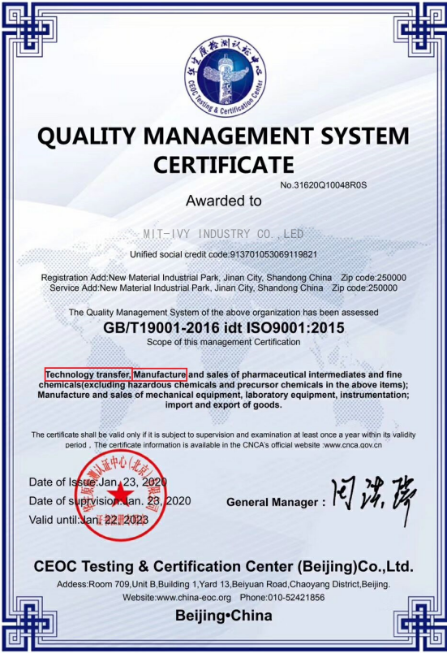
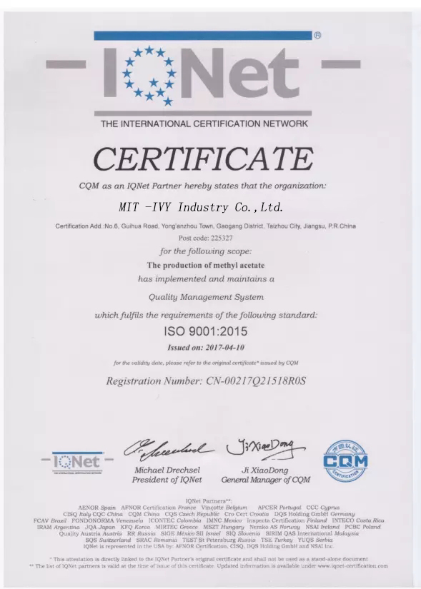
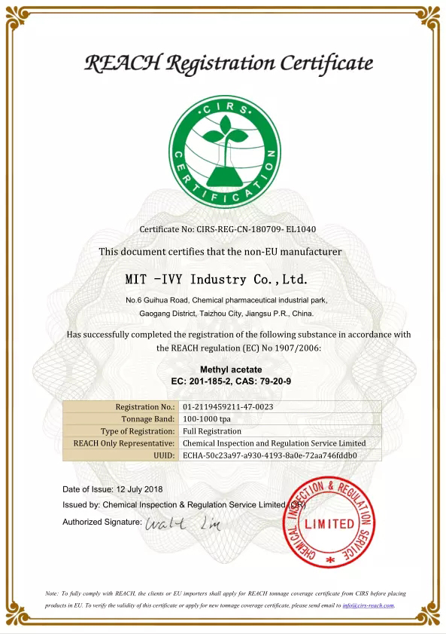
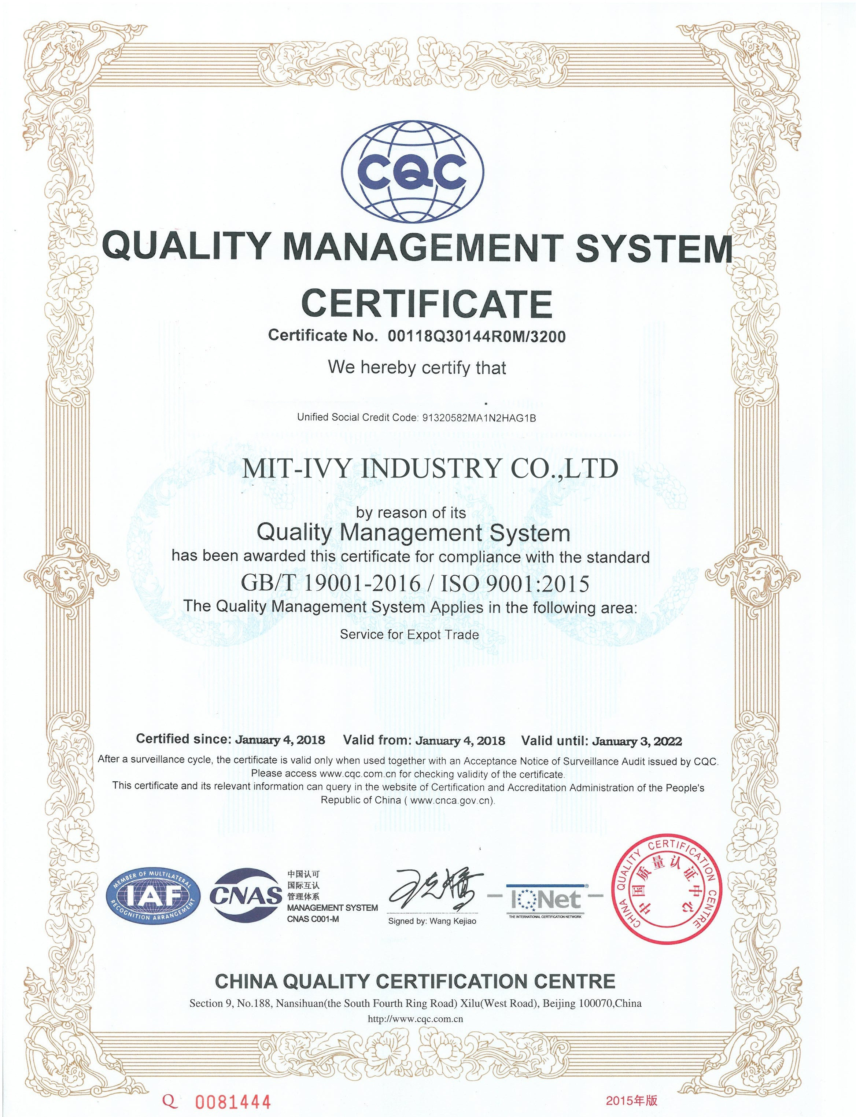
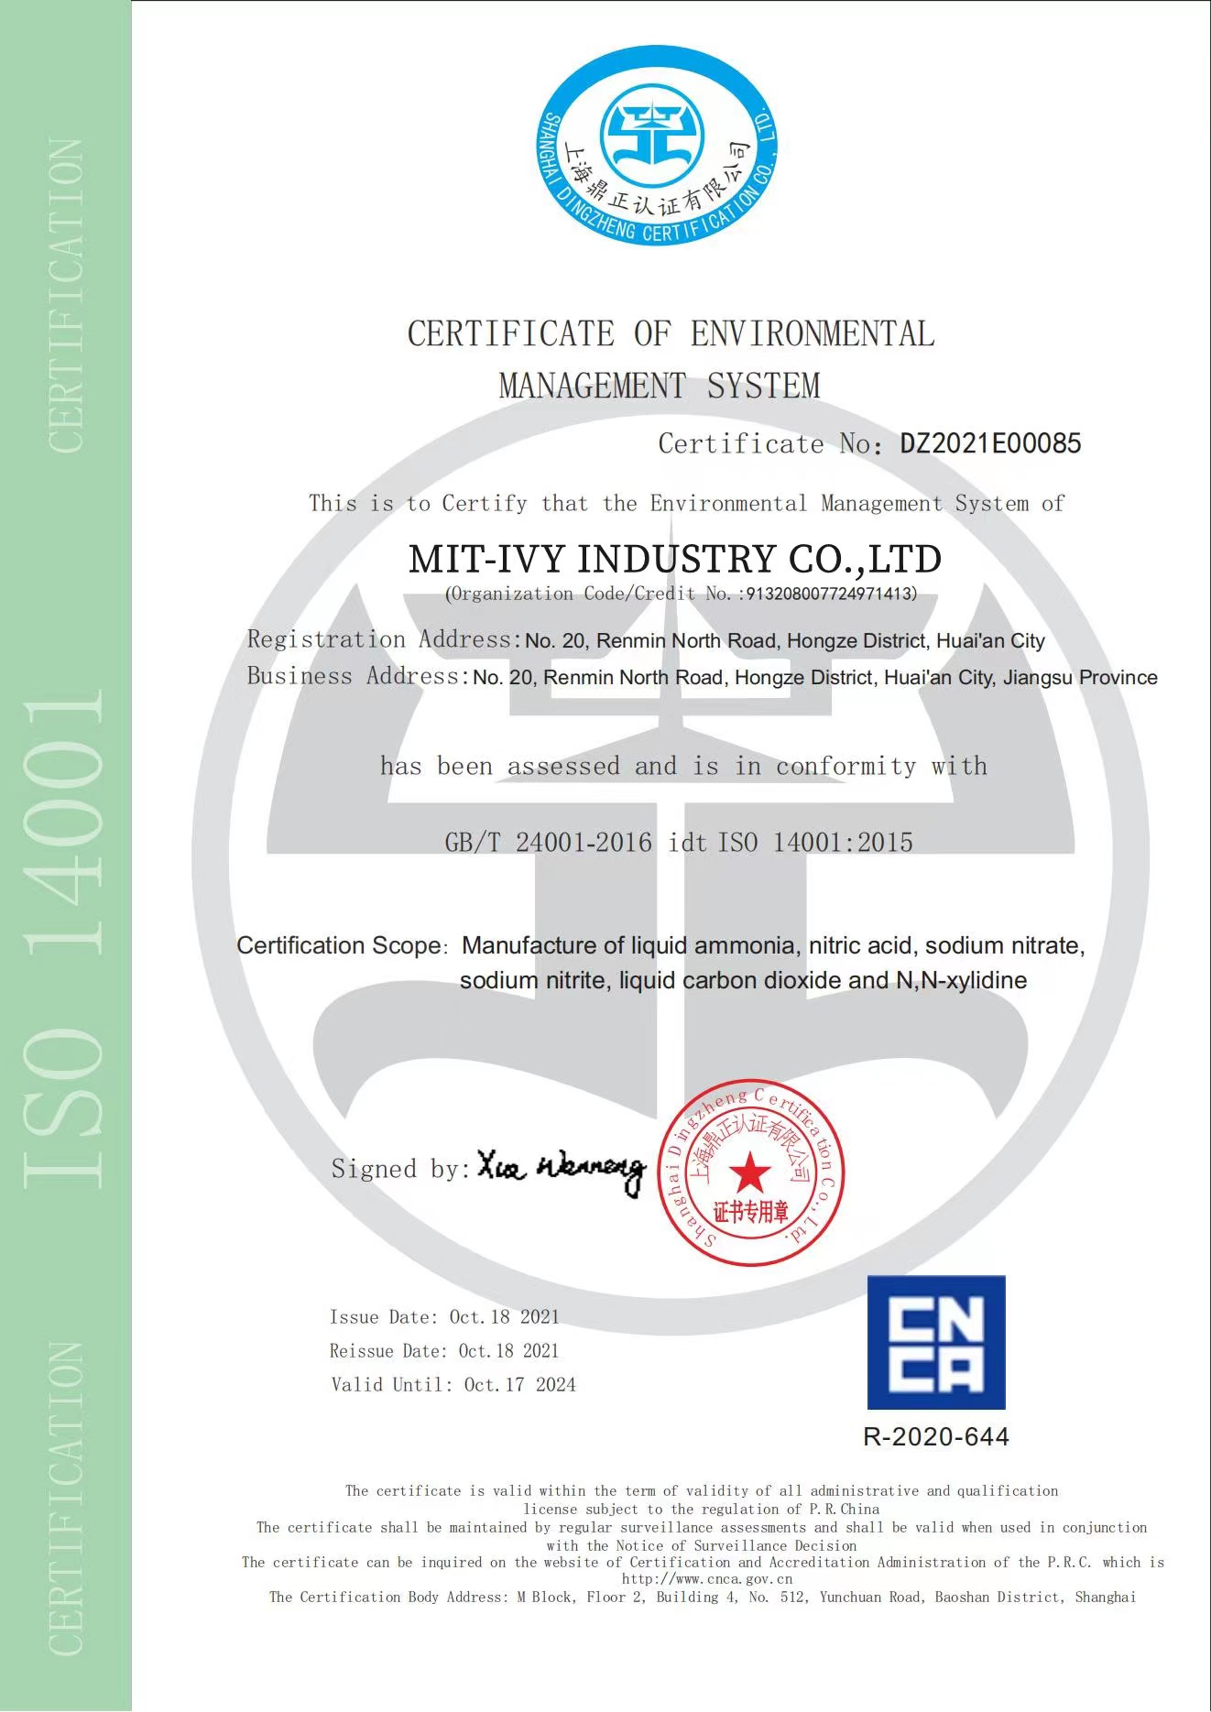
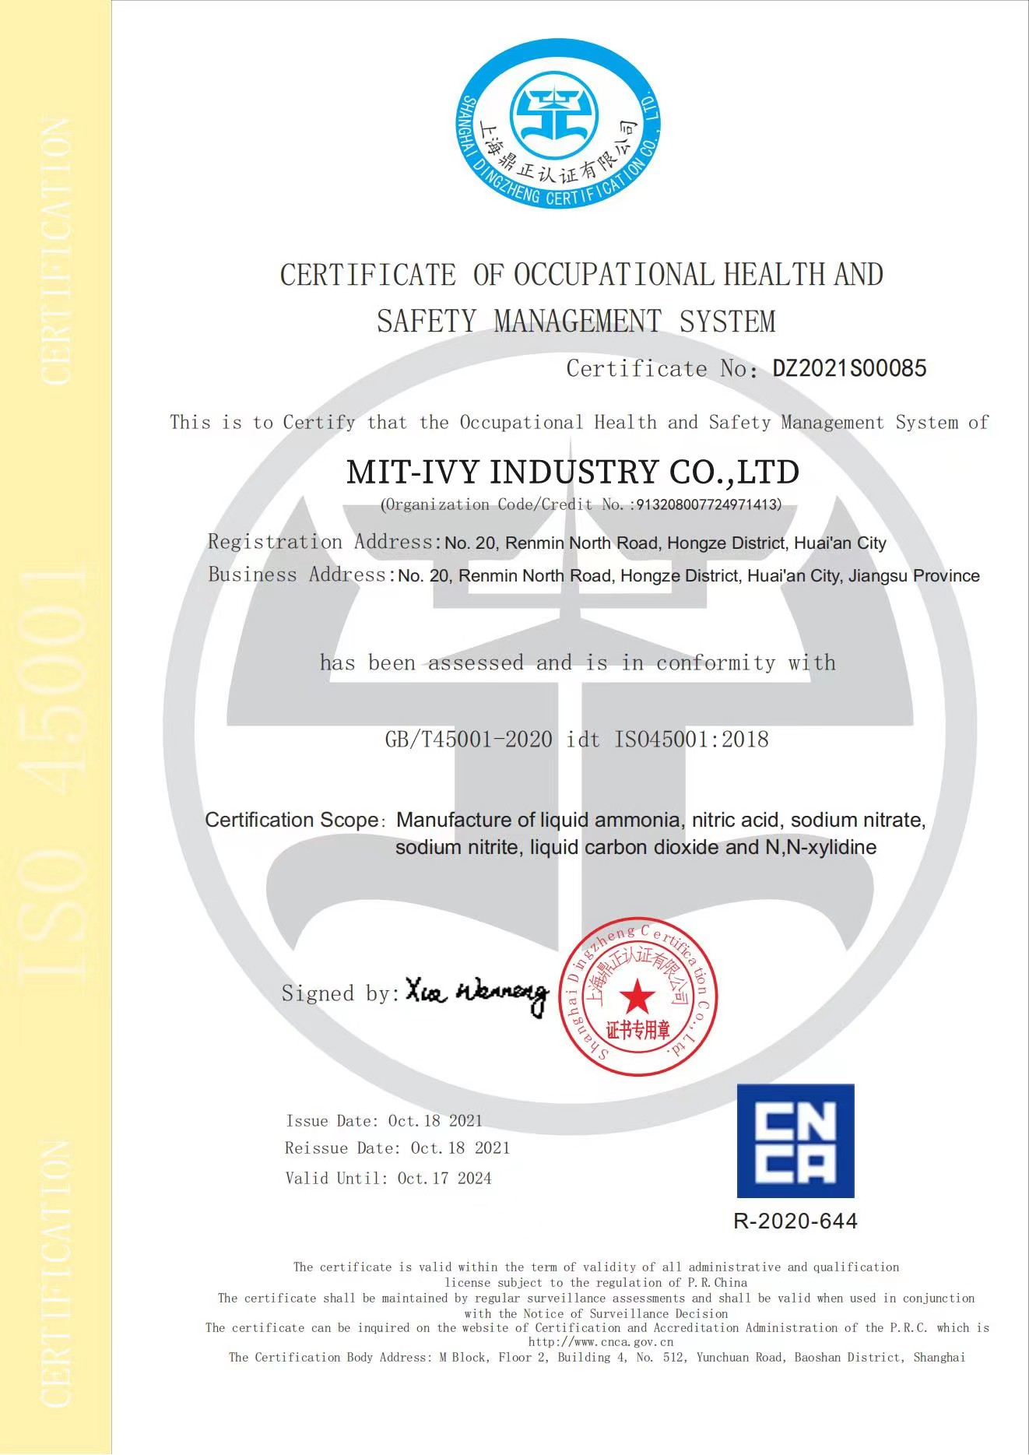
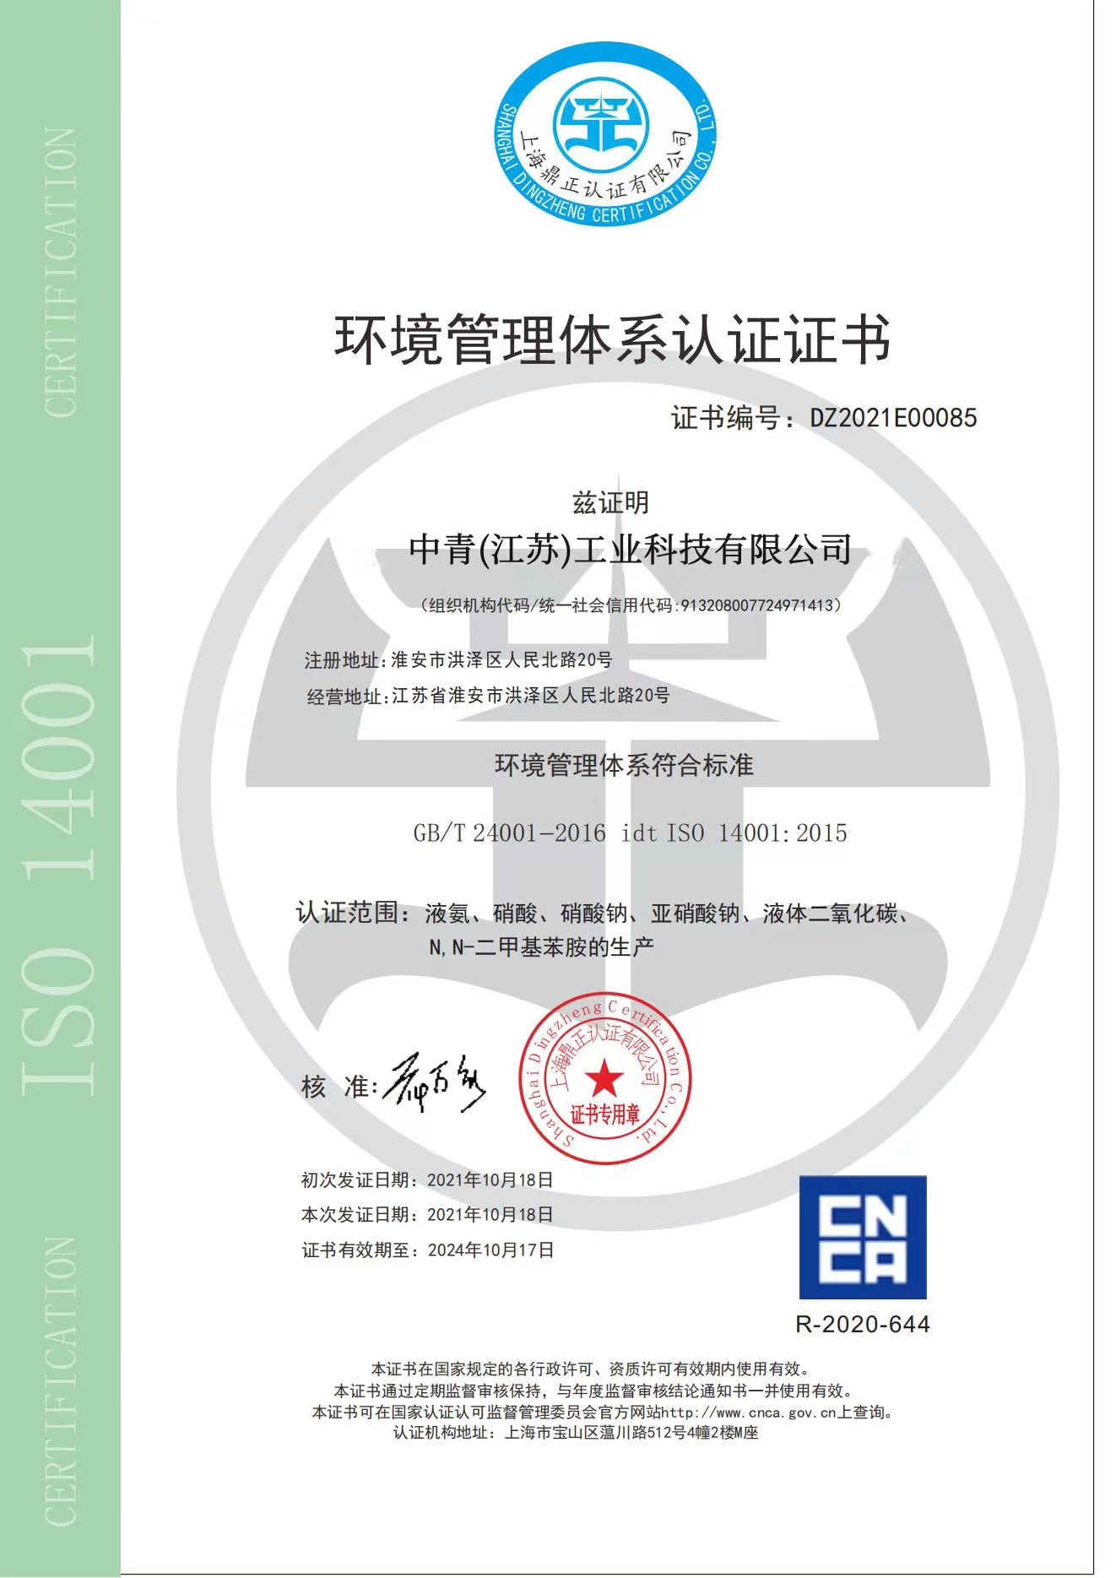
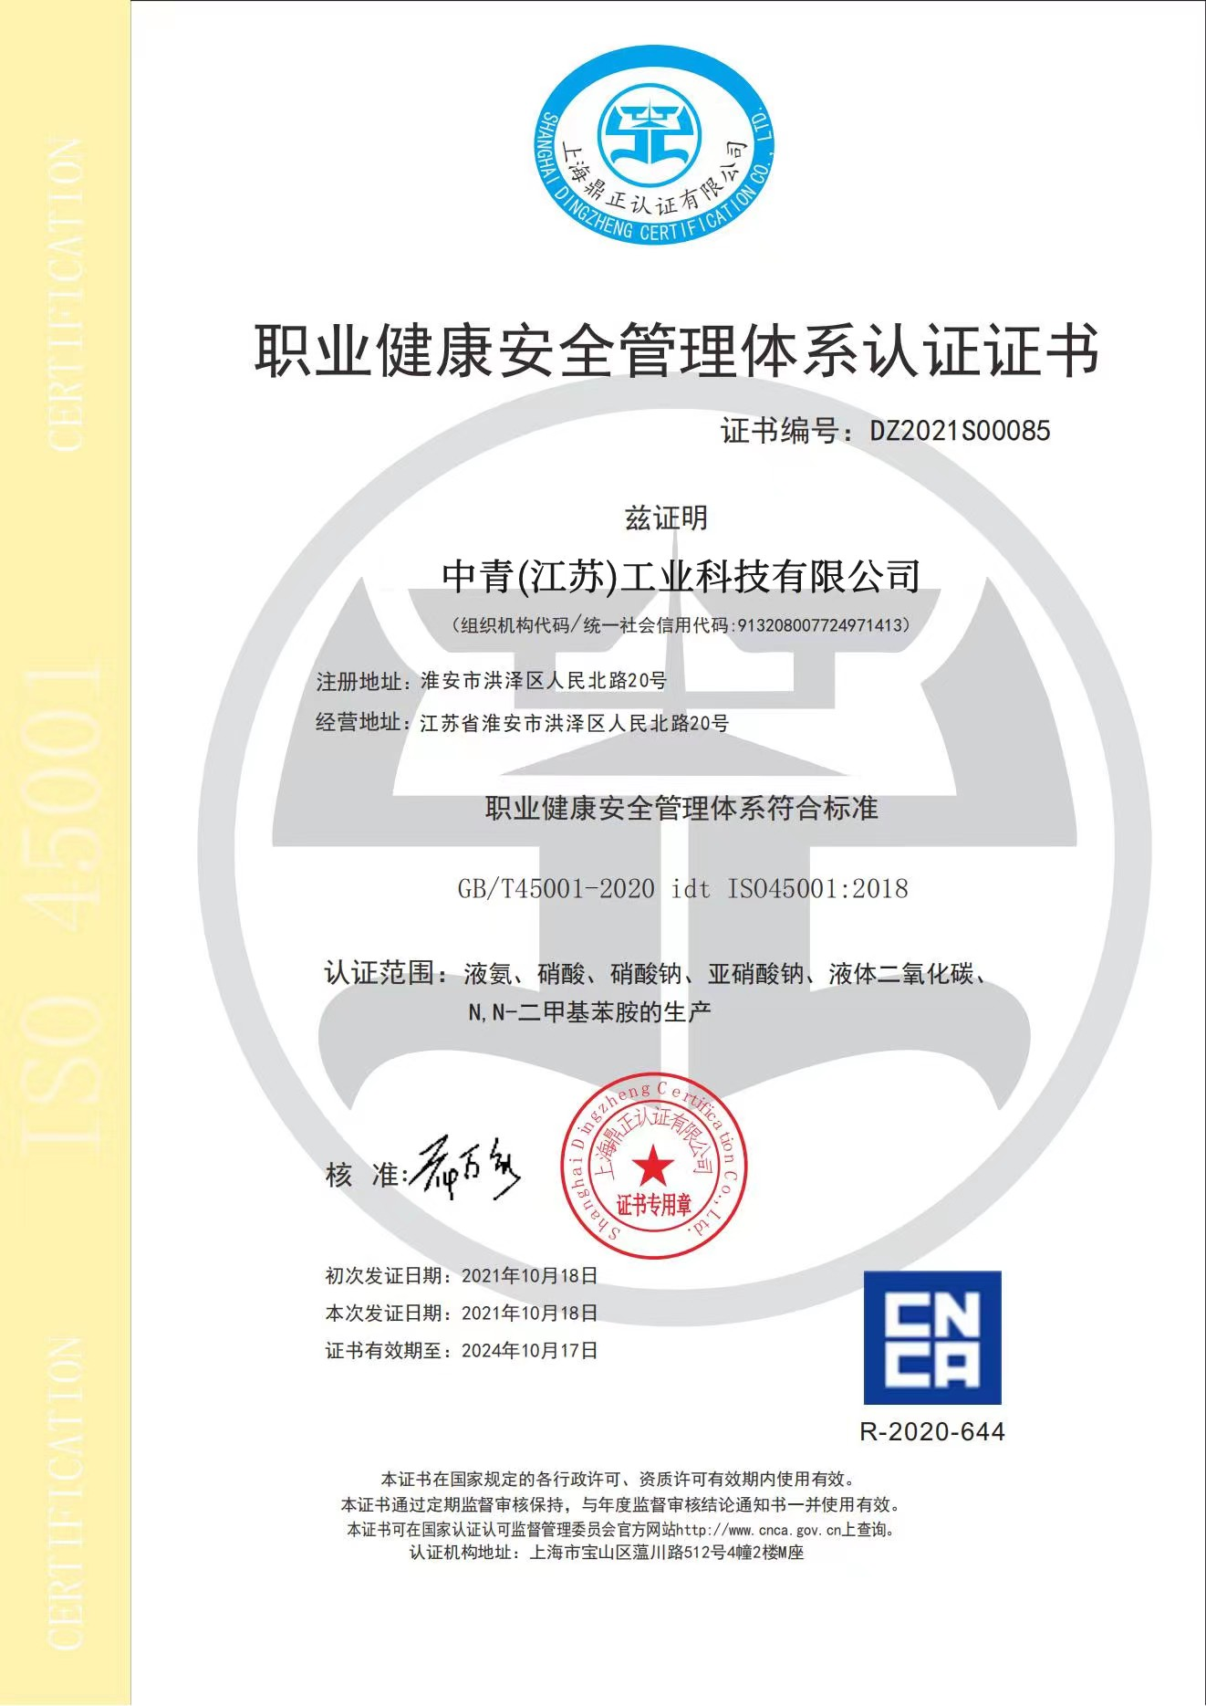
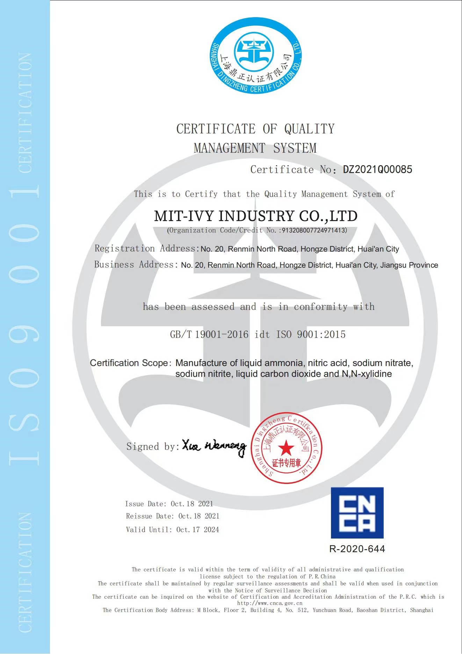
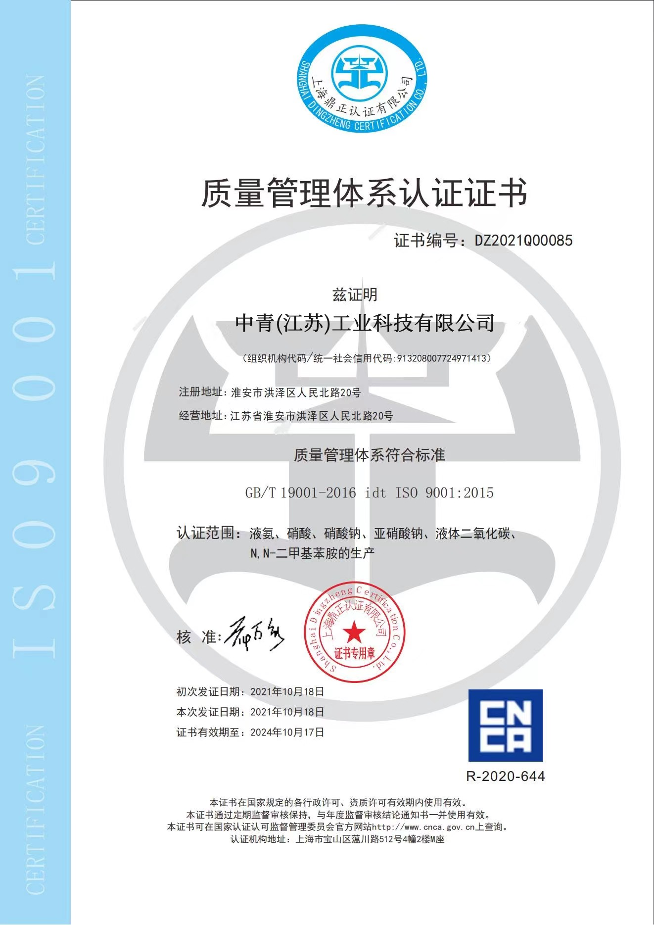
MIT-IVY Certificate

Slide 10

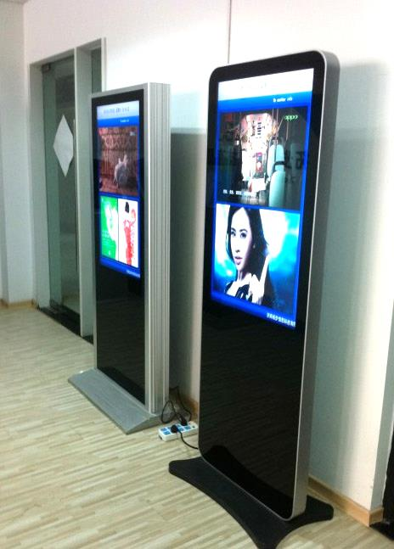
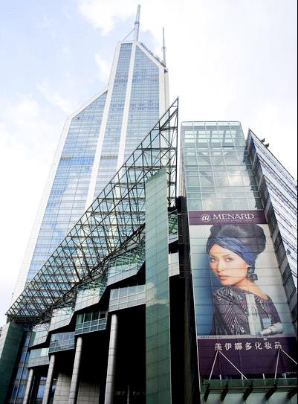

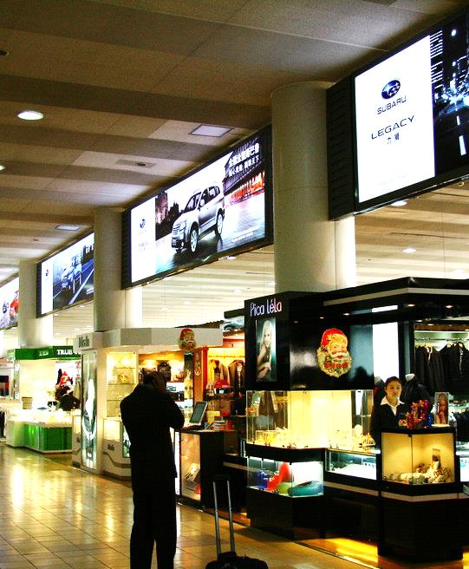
Company resources
capital
subsidiary
employee
Total area
Core technology
60 million
4
1500
500000
12

Slide 11
02
MIT-IVY INDUSTRY
COMPANY TEAM

Slide 12
Organizational structure
Board of directors
General manager
director
Fine chemical division
Strategic Planning
Financial center
Organization management center
Guangzhou MIT-IVY Industry
Science and technology Development
Financial accounting
Human resources
Changde Changlian Chemical Industry
Safety and Environmental Management Group
Analytical management
Infrastructure office
Anhui Yongchang Chemical Industry
Ministry of Justice
Finance department
Warehousing and logistics

Slide 13
03
MIT-IVY INDUSTRY
ENTERPRISE PRODUCTS

Slide 14
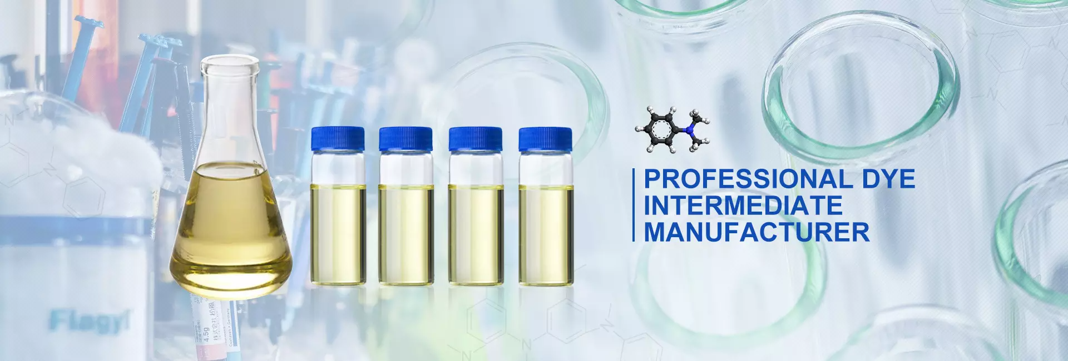
PRODUCT
Fine chemicals
organic intermediates
specialty chemicals

Slide 15
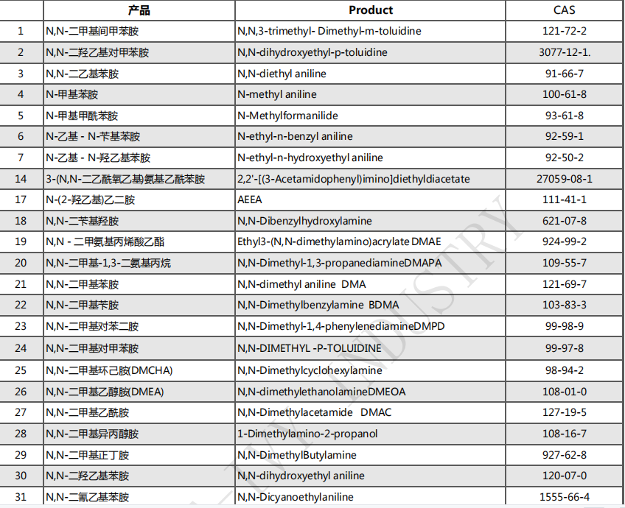

Slide 16
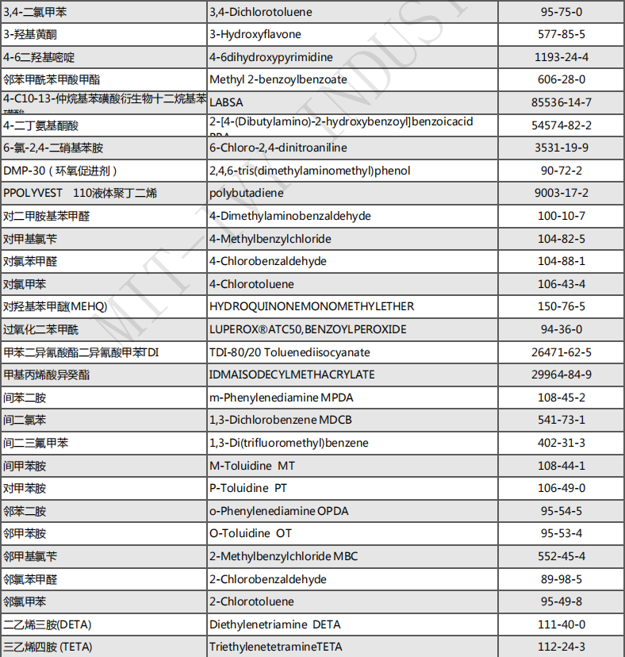

Slide 17
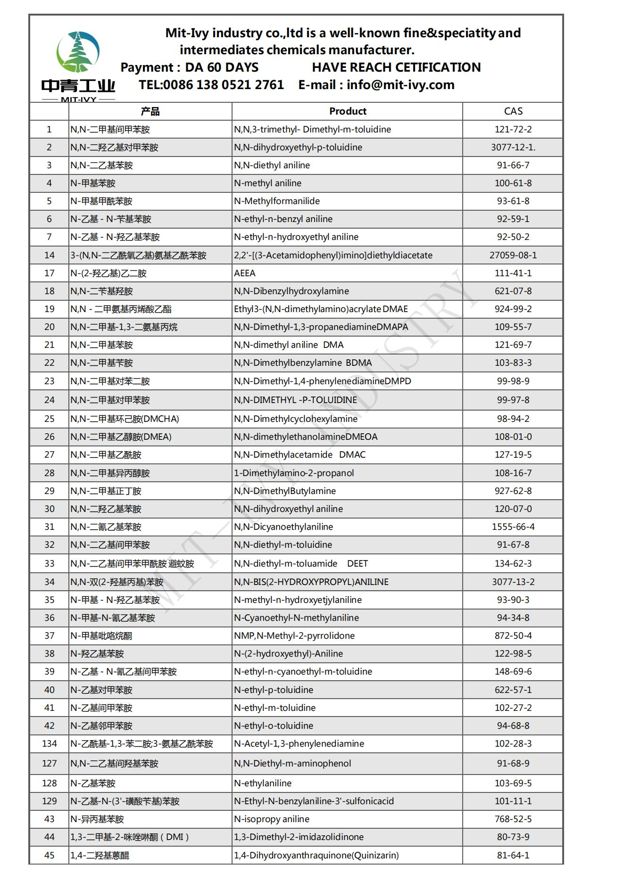
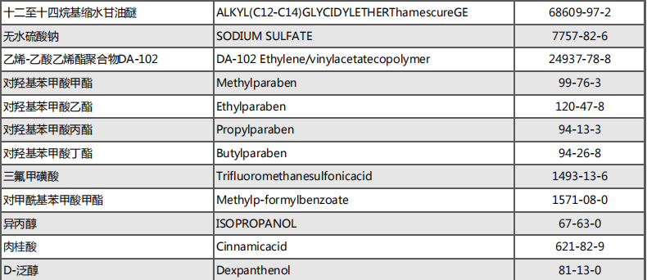

Slide 18
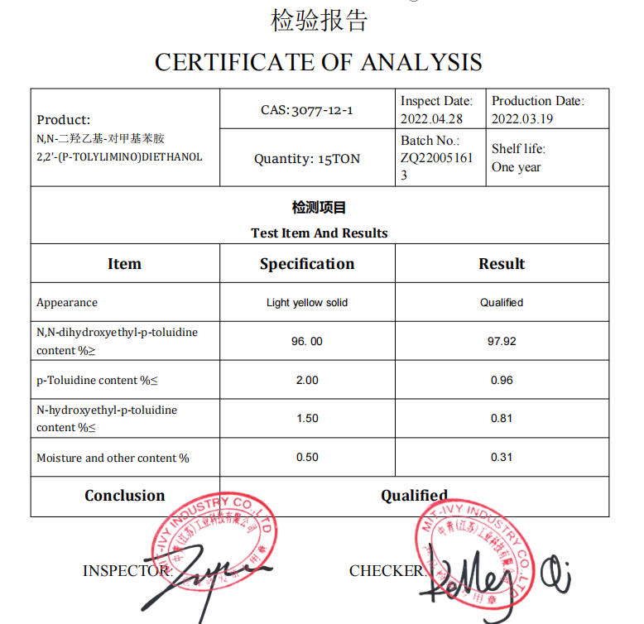
N,N-dihydroxyethyl-p-toluidine
CAS:3077-12-1
Uses: dye intermediate, pharmaceutical intermediate

Slide 19
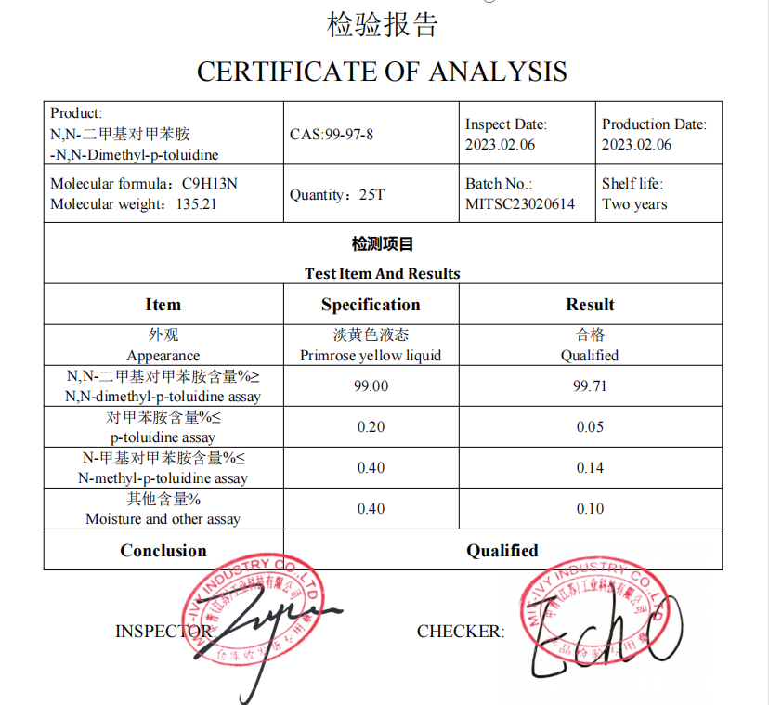
N,N-Dimethyl-p-toluidine
CAS:99-97-8
USES: used to make self-condensate water; Adhesive agent, cloud stone glue; Anchorage, coal production

Slide 20
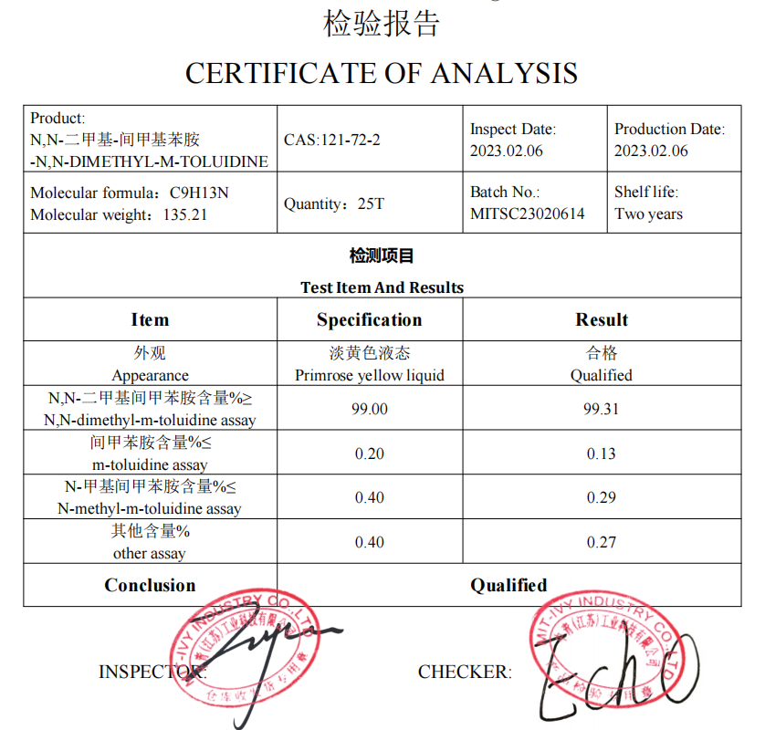
N,N-DIMETHYL-M-TOLUIDINE
CAS:121-72-2
Uses: dye intermediate, pharmaceutical intermediate

Slide 21
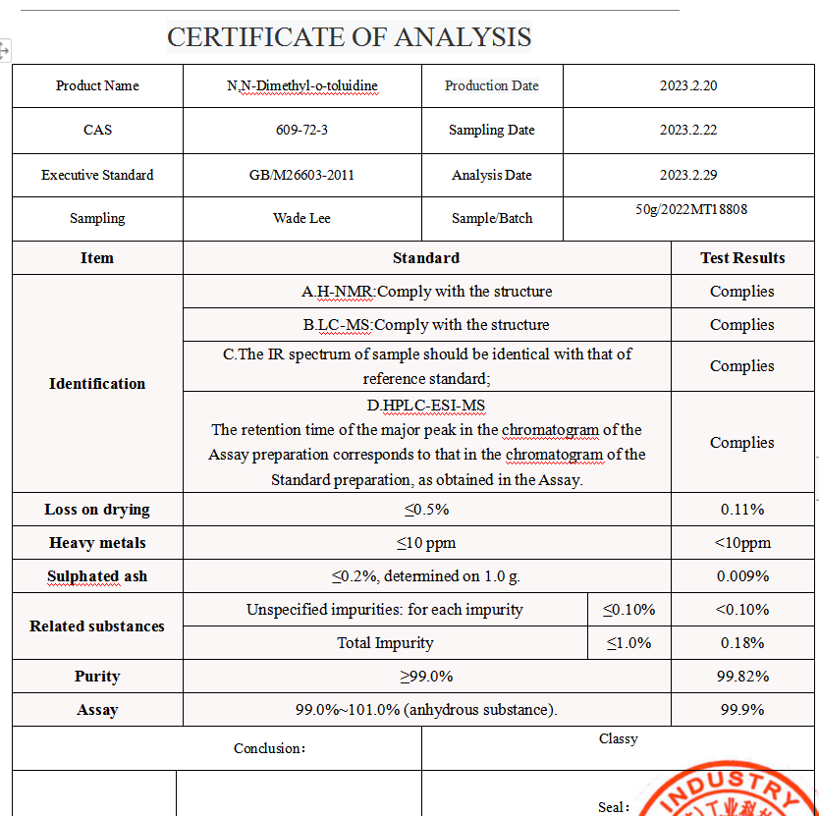
N,N-Dimethyl-o-toluidine
609-72-3
Uses: dye intermediate, pharmaceutical intermediate

Slide 22
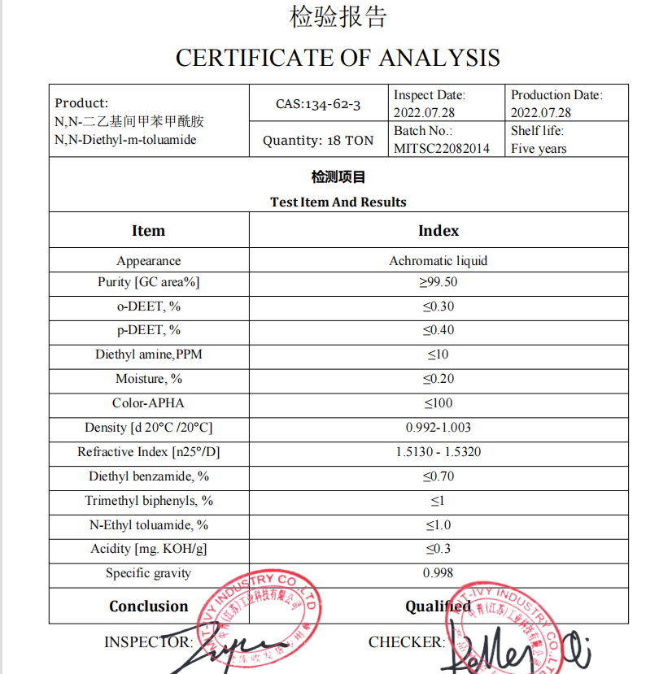
N,N-diethyl-m-toluamide DEET
CAS:134-62-3
USES: it is the most common active ingredient in insect repellent, protecting the skin, preventing mosquitoes, pimples, vagaries, typhus mites, leeches, and the bites of his insects.

Slide 23
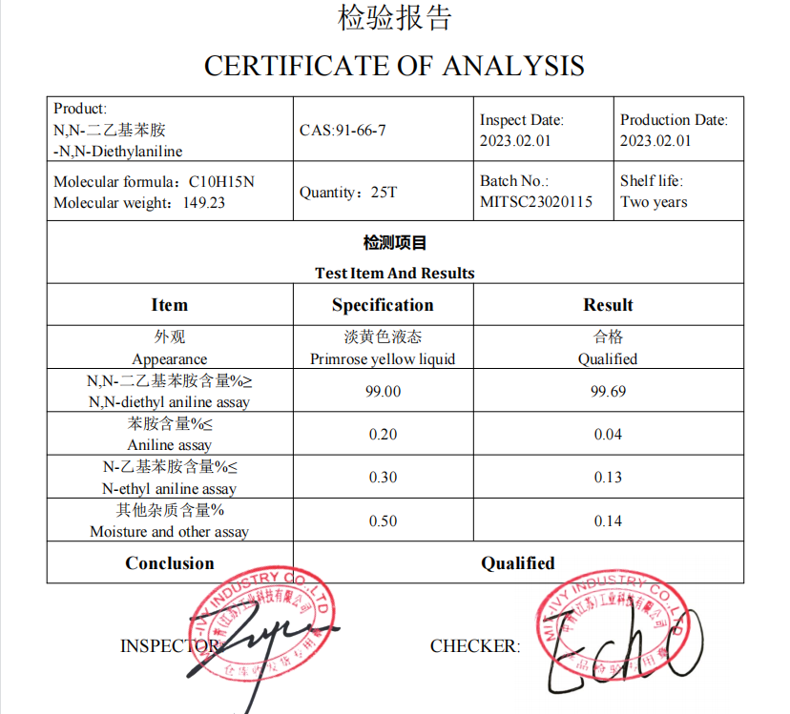
N,N-Diethylaniline
CAS:91-66-7
Uses: Used in dye intermediates, latex accelerators, pharmaceuticals, pesticides, etc. Used as an analytical reagent, also used in organic synthesis; Diethylaniline is mainly used in the production of azo dyes, triphenylmethane dyes, can prepare alkaline brilliant green, alkaline purple, acid lake blue V, etc. It is also an intermediate in the pharmaceutical industry and color film developer. Used as an analytical reagent and for the detection of zinc and manganese.

Slide 24
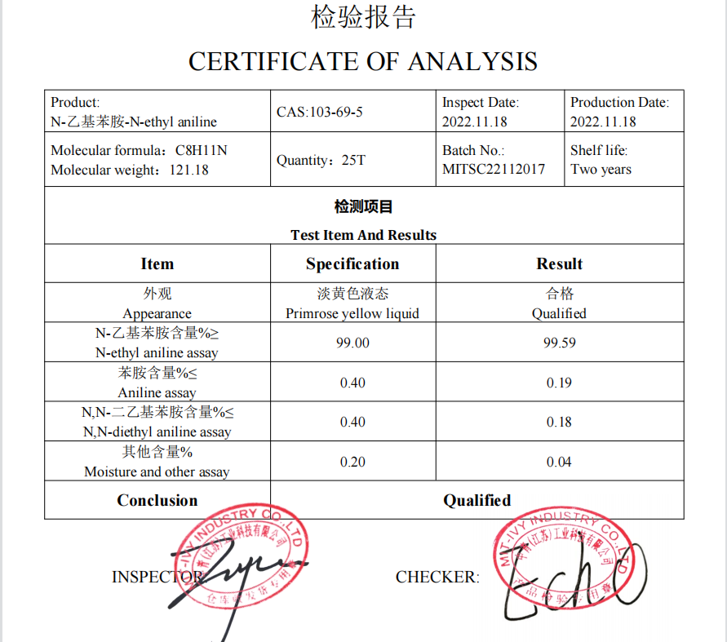
N-ethyl aniline
CAS:103-69-5
Uses: Used as pesticide and dye intermediate, rubber accelerator, etc
Used in organic synthesis, it is an important intermediate of azo dyes and triphenylmethane dyes; It can also be used as an intermediate of fine chemicals such as rubber auxiliaries, explosives and photographic materials.

Slide 25
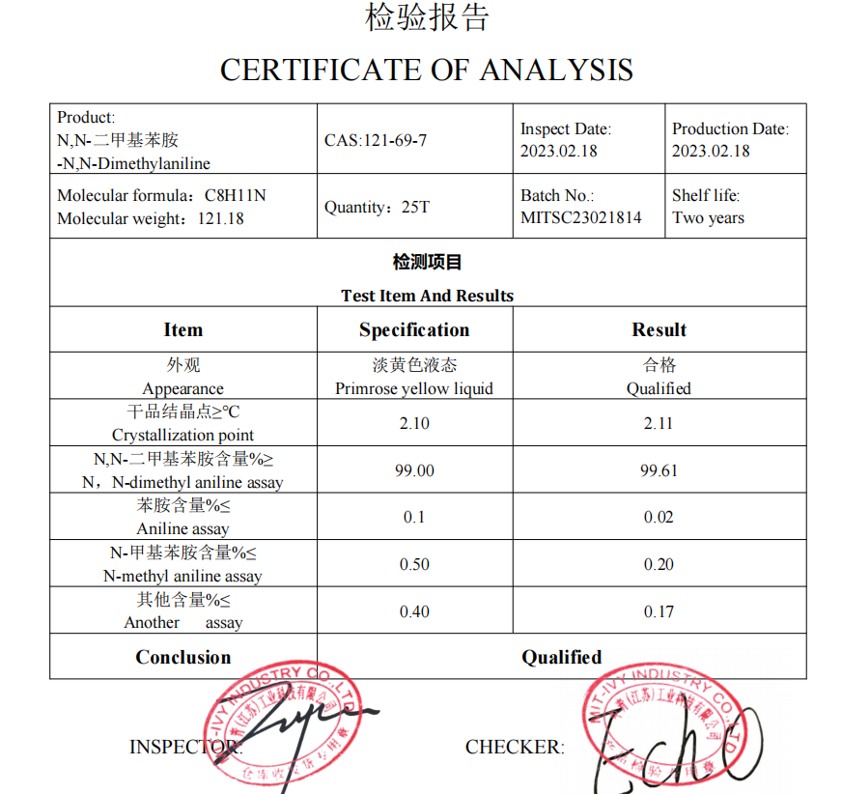
N,N-Dimethylaniline
CAS:121-69-7
Use: One of the basic raw materials for the production of basic dyes (triphenyl methane dyes, etc.) and alkaline dyes, the main varieties are alkaline light yellow, alkaline purple 5BN, alkaline green, alkaline lake blue, brilliant red 5GN, brilliant blue and so on. N, n-dimethylaniline is used in the pharmaceutical industry for the manufacture of cephalosporin V, sulfa-B-methymine, sulfadimethoxil, fluoropyrimine, etc., and in the fragrance industry for the manufacture of vanillin.

Slide 26
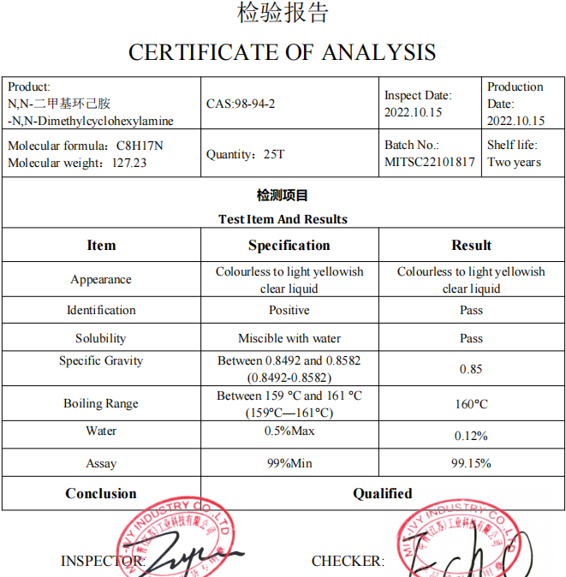
N,N-Dimethylcyclohexylamine DMCHA
CAS:98-94-2
Uses: As catalyst, intermediate of rubber accelerator, and for fabric treatment

Slide 27
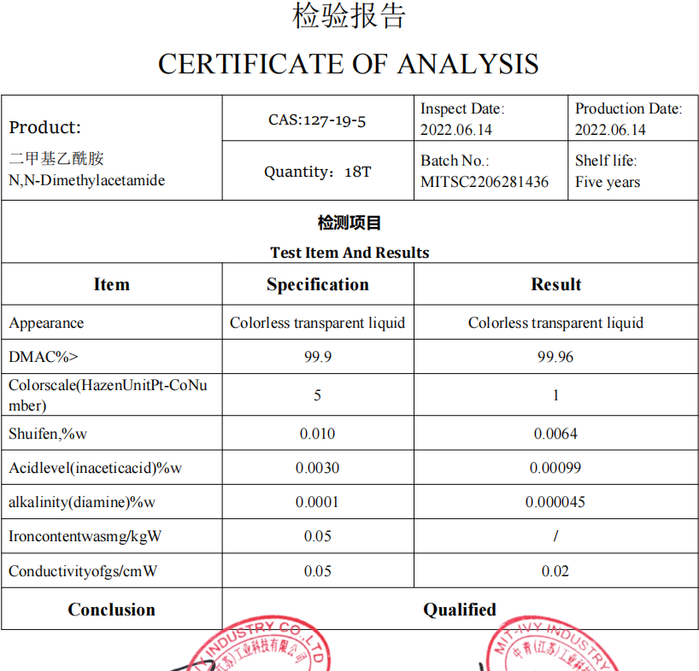
N,N-Dimethylacetamide DMAC
CAS:127-19-5
Use: colorless transparent liquid. It can be mixed with organic solvents such as water, alcohol, ether, ester, benzene, trichloromethane and aromatic compounds.
1. Solvent for separating alkanes from aromatics.
2. In the pharmaceutical industry, dimethyl sulfoxide can also be used as a raw material and carrier for some drugs.

Slide 28
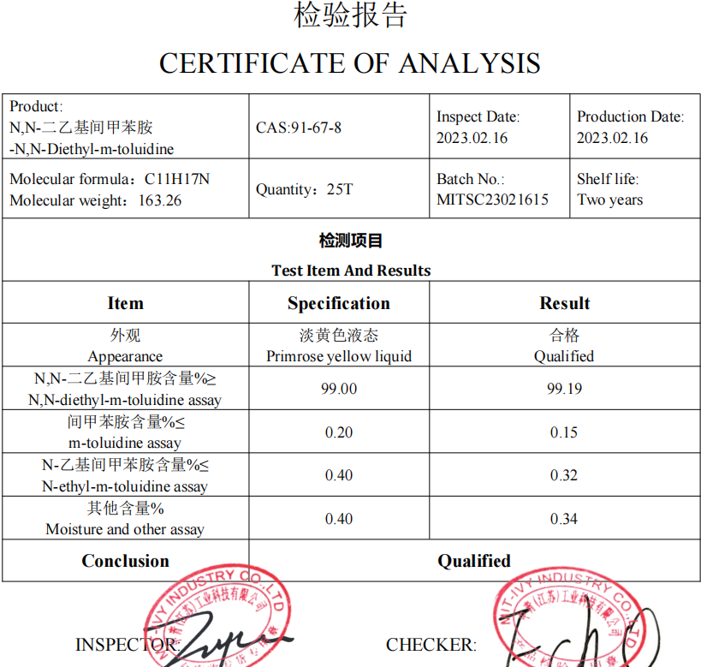
N,N-Diethyl-m-aminophenol
CAS:91-67-8
Use: dye intermediate. Used to produce weak acid brilliant blue BA and other dyes. It can also be used to synthesize the positive color agent CD-2 for color development

Slide 29
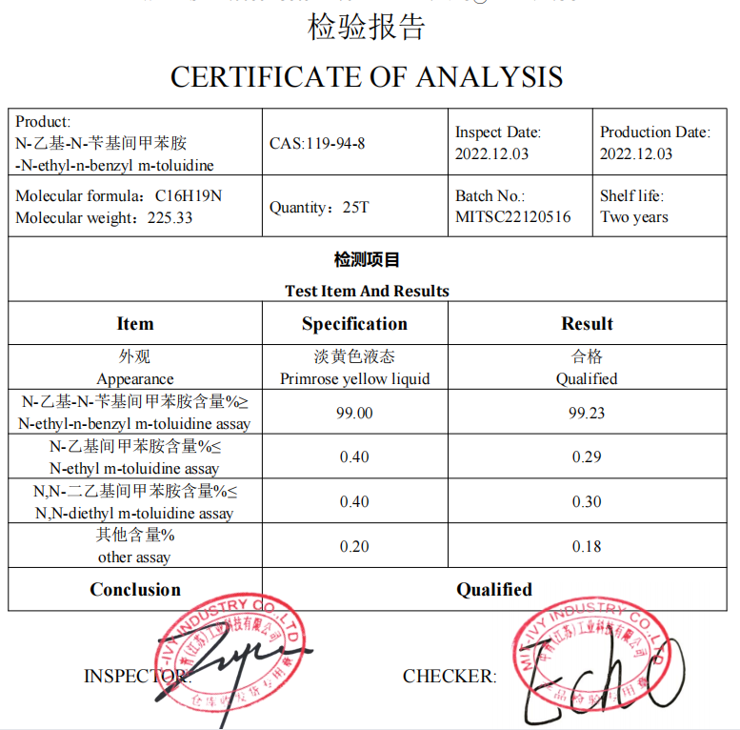
N-ethyl-n-benzyl-m-toluidine
CAS:119-94-8
Uses: Used in organic synthesis, as intermediate of acid blue 90, 91, 109 and other dyes

Slide 30
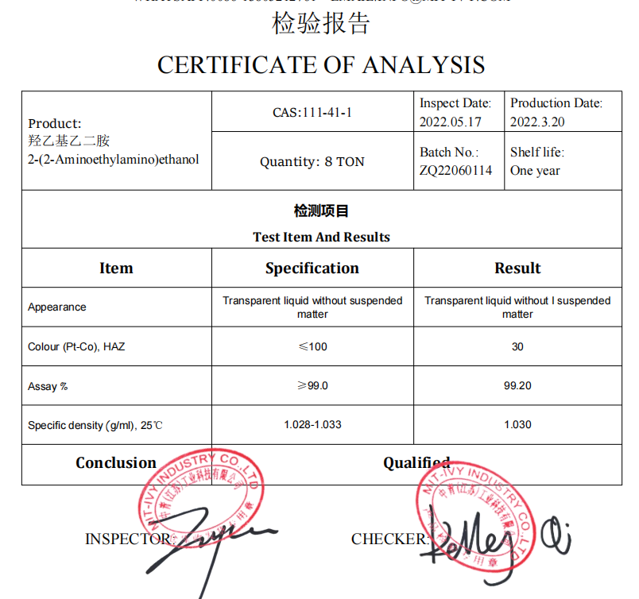
2-(2-Aminoethylamino)ethanol AEEA
CAS:111-41-1
Uses: 1. Used in shampoo, lubricant, oil buffer, resin synthesis, textile additives, imidazoline amphoteric surfactant, etc
2. Used as curing agent for plastics
3. For organic synthesis
4. Used in the production of dyes, resins, rubber, flotation agents, pesticides, surfactants, the preparation of corrosion inhibitor 1017 for petrochemical production. The product is an excellent low-toxicity Chemicalbook curing agent for epoxy resin at room temperature, which is obviously superior to ethylenediamine. Used with epoxy resin, it is widely used for bonding various metal and non-metal parts, preparing anti-corrosion epoxy coatings, casting cable joints and other mechanical and electrical parts.
5. Mainly used as cationic, zwitterionic surfactant raw materials; Can also be used as epoxy resin curing agent, other fine chemical products of raw materials.

Slide 31
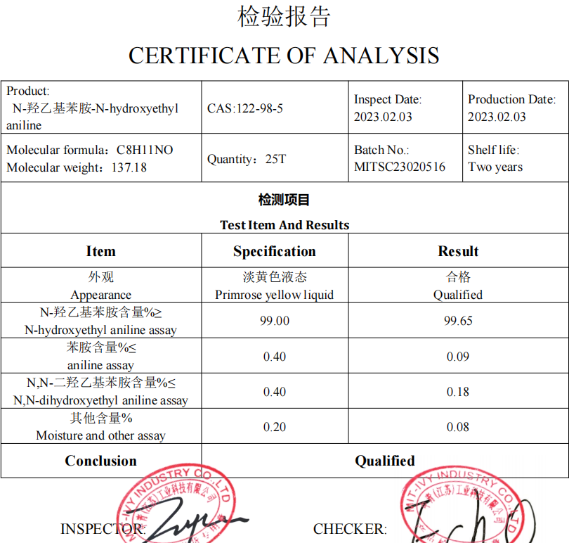
N-hydroxyethylaniline
CAS:122-98-5
Uses: dye intermediate, pharmaceutical intermediate

Slide 32
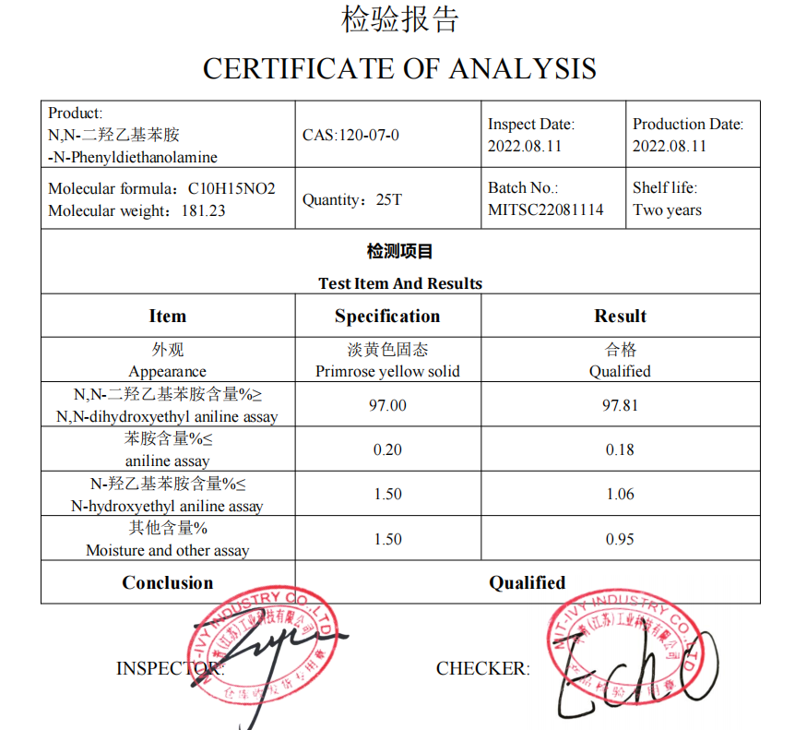
N-Phenyldiethanolamine
CAS:120-07-0
Uses: dye intermediate, pharmaceutical intermediate

Slide 33
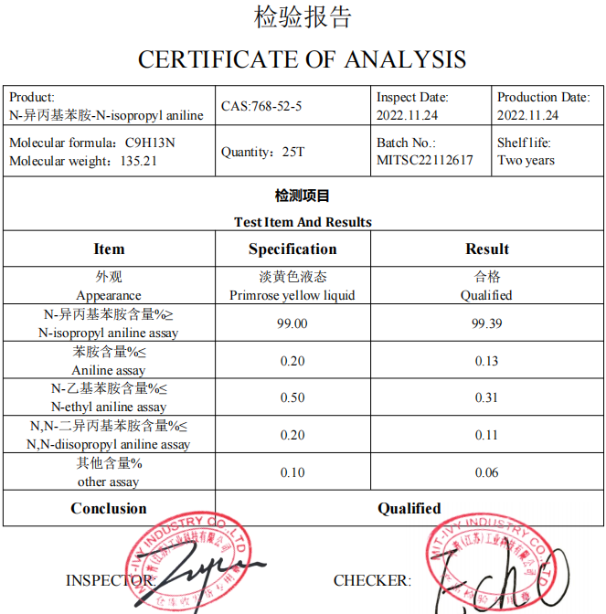
N-isopropyl aniline
CAS:768-52-5
Uses: dye intermediate, pharmaceutical intermediate

Slide 34
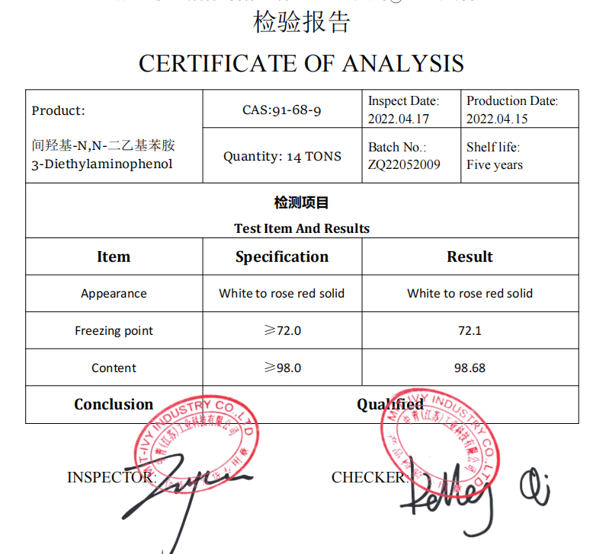
N,N-Diethyl-m-aminophenol
CAS:91-68-9
Uses: This product is the intermediate of rose essence, acid pink, alkaline red and other dyes, and is also used in other organic synthesis. Uses Chemical reagents, fine chemicals, pharmaceutical intermediates, material intermediates

Slide 35
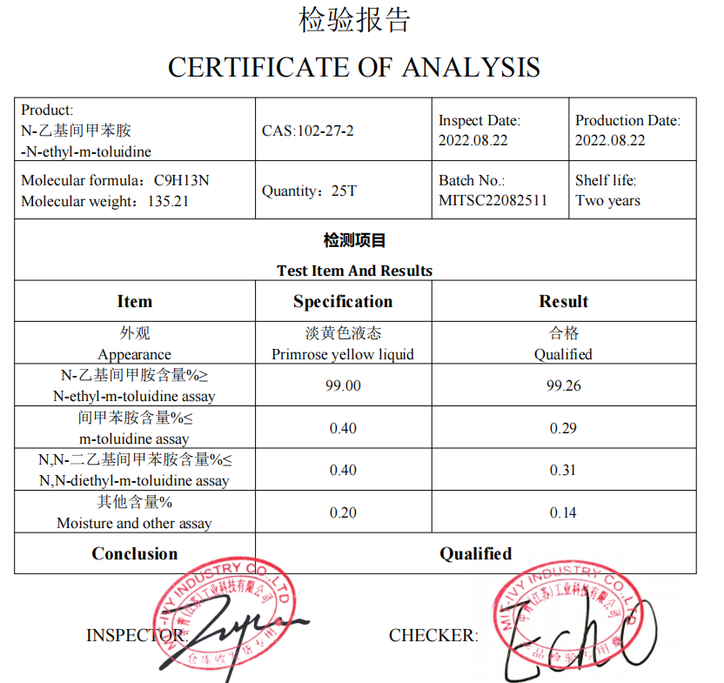
N-ethyl-m-toluidine
CAS:102-27-2
Use: dye intermediate. For the synthesis of organic dyes, such as the preparation of triphenylmethane acid dyes, azo acid dyes and fluorotriazine reactive dyes, polyester fiber yellow disperse dyes and cationic dyes suitable for acrylic fiber dyeing; Synthetic organic pigments, using ETLD as raw material, can produce monoazo and bisazo organic pigments. It can also be used to synthesize color developers

Slide 36
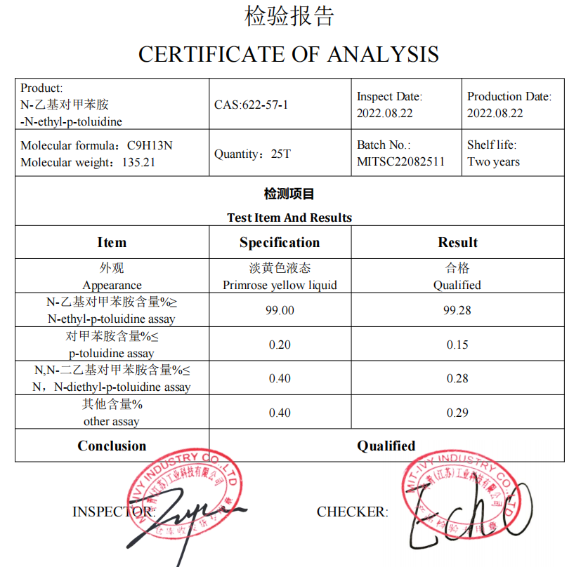
N-ethyl-p-toluidine
CAS:622-57-1
Uses: dye intermediate, pharmaceutical intermediate

Slide 37
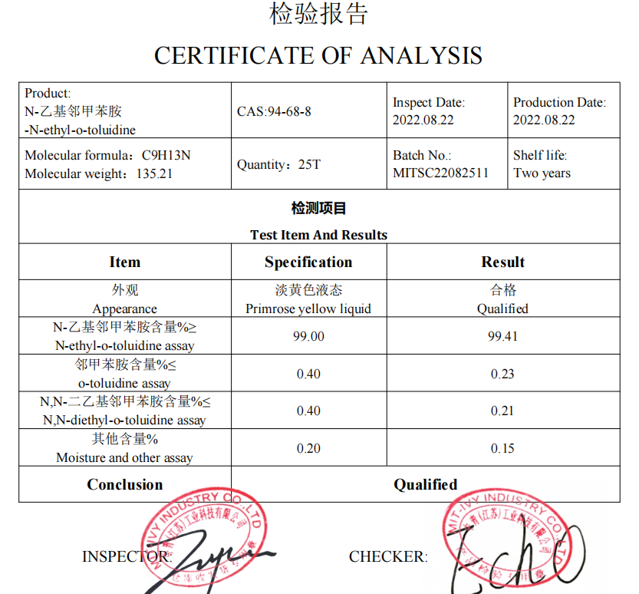
N-ethyl-o-toluidine
CAS:94-68-8
Uses: dye intermediate, pharmaceutical intermediate

Slide 38
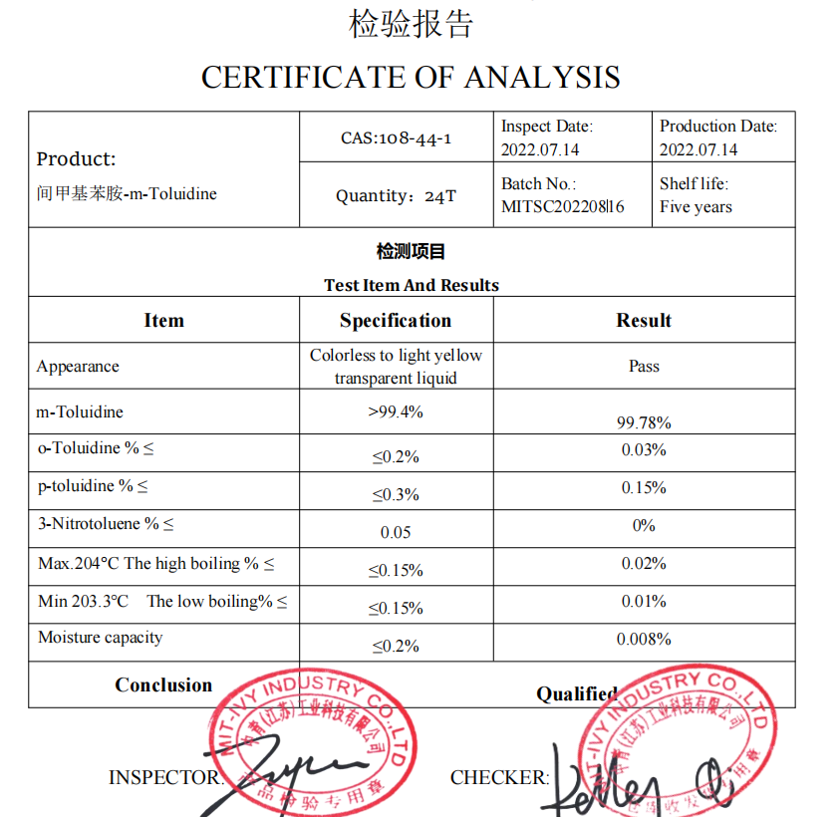
m-Toluidine
CAS:108-44-1
Usage: 1. Used as an intermediate of cationic dye and color film developer
2. Used as an analytical reagent, also used in the synthesis of organic and dyes
3. The product is an intermediate of active yellow X-R and cationic violet 2RL.
4. M-toluidine (108-44-1) is used as a solvent for polyester resins, an additive for polyurethane foams, an intermediate for azo dyes and cationic resins.
5. Verification of osmium, palladium, platinum, ruthenium and nitrite

Slide 39
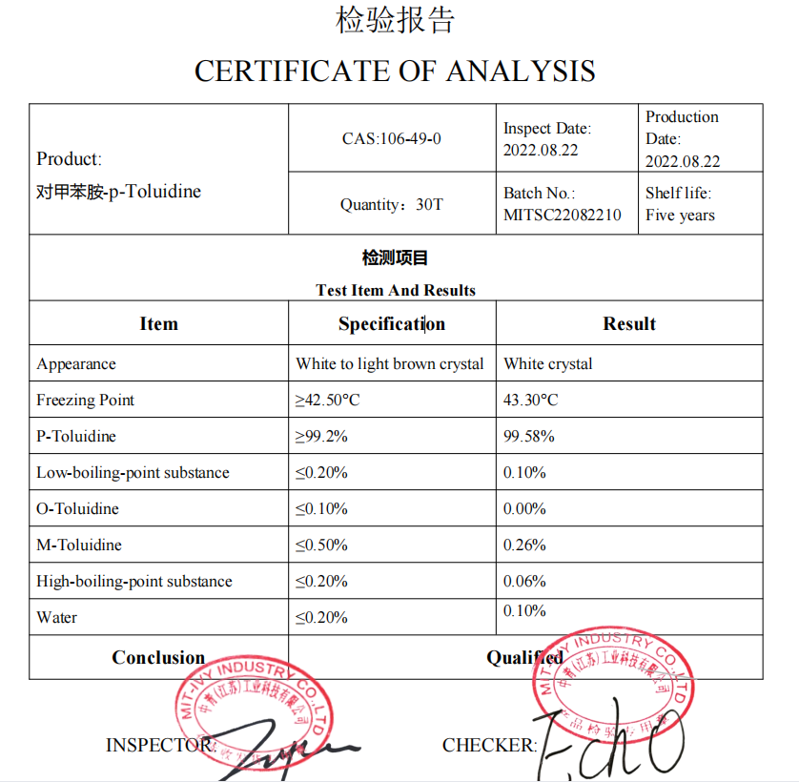
p-Toluidine
CAS:106-49-0
Use: 1. Used as an analytical reagent, also used in the synthesis of dyes
2. Used as intermediate of dyes, medicines and pesticides
3. Mainly used as dye intermediates for the production of red GL, methyl amine red lake, basic fuchsin, methyl peritroic acid and 4-amino-toluene-3-sulfonic acid, triphenylmethane dye and oxazine dye. It is also used as an intermediate in medicine pyrimethamine, pesticide chloroxylon and other products.
4. Photometric determination of gold, titanium (III), tungsten. Detection of deposit, silver, osmium, platinum, nitrate, nitrite, phloroglucinol and lignin. Determination of carboxylic acid and sulfonic acid. Solvent for molecular weight determination. Organic synthesis is used to produce 4B acid and synthetic dyes.

Slide 40
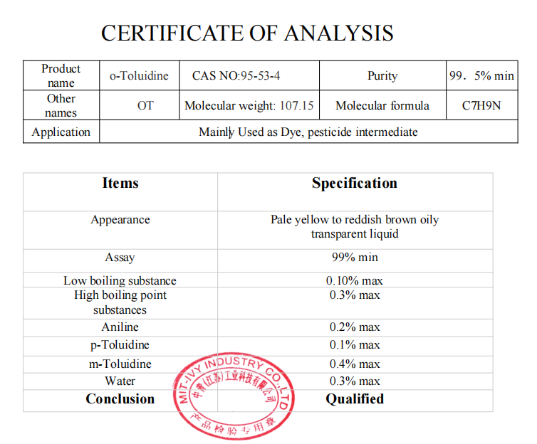
o-Toluidine
CAS :95-53-4
Uses: dye intermediate, pharmaceutical intermediate

Slide 41
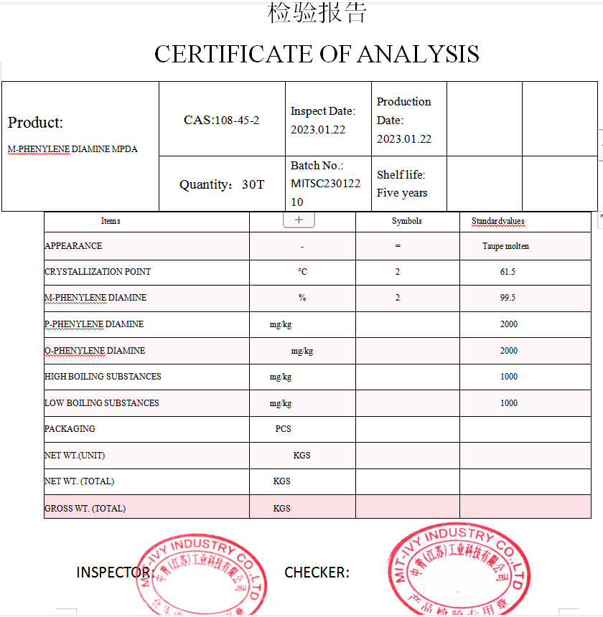
M-PHENYLENE DIAMINE MPDA
CAS:108-45-2
Uses: 1. Used as analytical reagent, resin curing agent and polymerization inhibitor, also used in the synthesis of dyes
2. Mainly used as dye intermediate and epoxy resin curing agent
3. Azo dyes and azine dyes intermediates, mainly used in the manufacture of direct fast black RN, alkaline orange, alkaline brown G, direct fast black G and other dyes, and used as fur dyes, in Japan, azo dyes consumption of m-phenylenediamine accounted for 90% of the total consumption. Also used as curing agent of epoxy resin, coagulant of cement, and used in hair color water, mordant, color development agent and so on.
4. Spectrophotometric determination of nitrite, determination of bromate, bromide, chromate, ozone, gold, copper, dichromate, iron, oxygen and platinum, determination of active chlorine, chromium, iridium, nitrite and palladium.

Slide 42
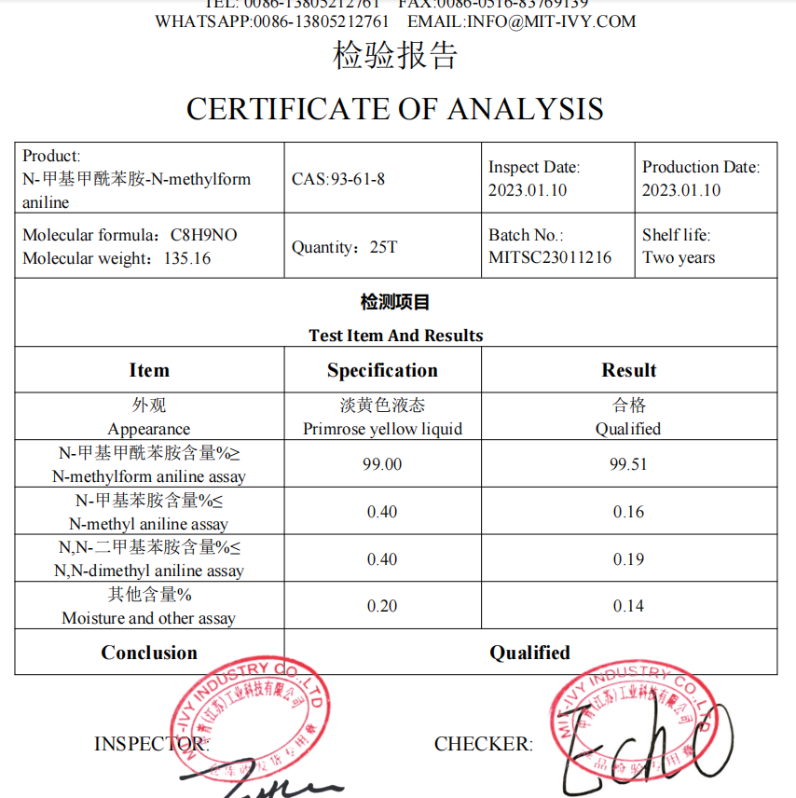
N-Methylformanilide
CAS ：93-61-8
Uses: 1. Used as organic synthesis intermediate, organic intermediate 2. Aromatic aldehyde

Slide 43
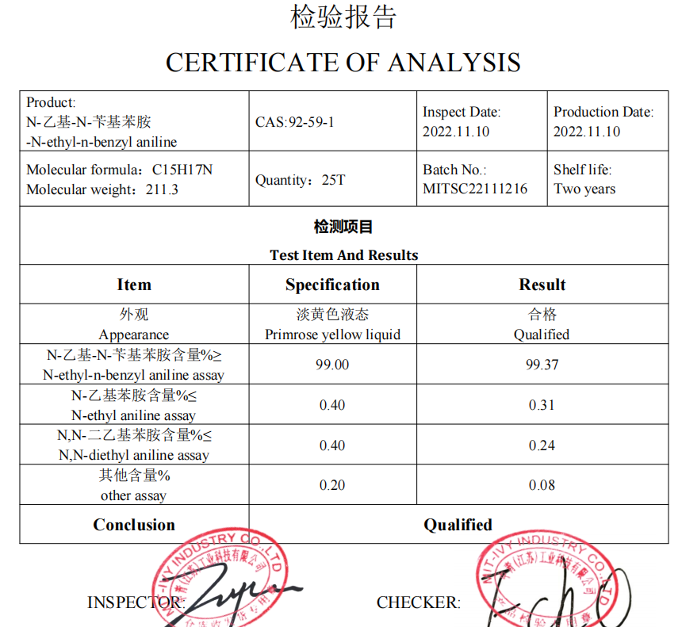
N-ethyl-n-benzyl aniline
CAS:92-59-1
Use: 1. Used as intermediate of acid orange 50, red 119, blue 5, 7 and green 5, 15, 65, cationic blue 65 and other dyes
2. Dye intermediates. Used to make acid light green SF and other blue dyes.
3. Make dye. Organic synthesis.

Slide 44
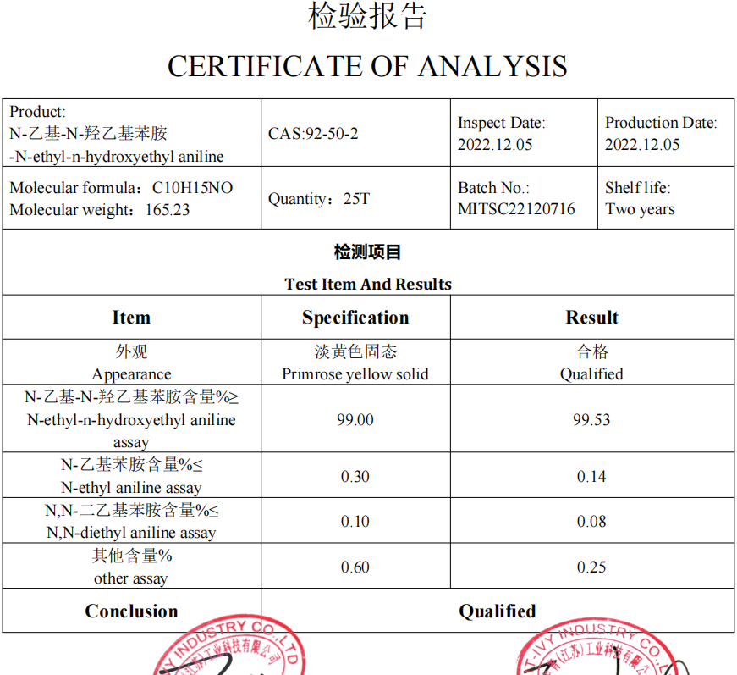
N-ethyl-n-hydroxyethyl aniline
CAS:92-50-2
Usage: 1. Used as intermediate of dyes and organic pigments
2. Used as an intermediate for dispersing red 1, 8, 13 and 76, orange 10, acid red 53, basic red 18, 24 and other dyes.

Slide 45
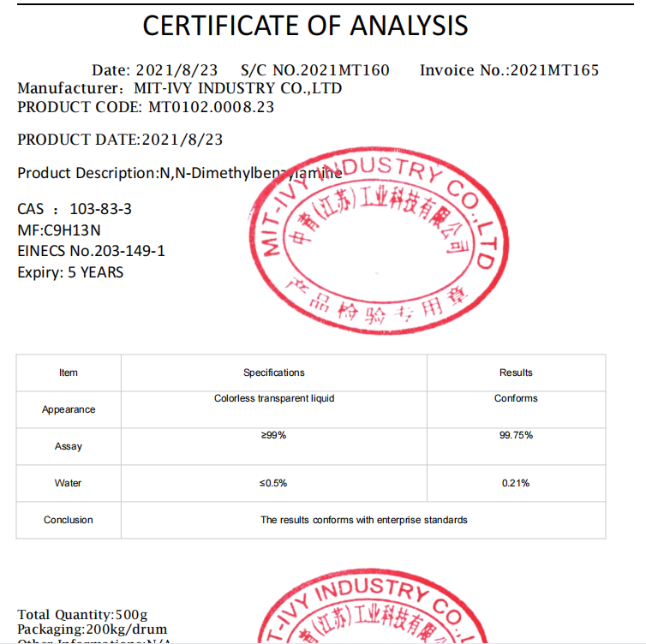
N,N-Dimethylbenzylamine
CAS ：103-83-3
Use:1) as an organic synthetic intermediate, can also be used as dehydrogenation catalyst, preservative, acid neutralization agent and so on
2) for organic synthesis
3) organic synthetic intermediates, which are used to make new jays for the production of new jays, corrosion agents, acid neutralizing agents, and electron microscopies to be covered with accelerators.
4) this product is organic synthetic intermediates such as synthetic quature-ammonium salt, etc., and also used for dehydrogenation catalysts, preservatives, neutralization agents, etc
5) 18-methyl nornorone, the intermediates of trienolone, the synthesis of the d-ring in the steroid compound
6) organic synthesis intermediates, catalysts; Corrosion inhibitor; Acid neutralizing agent; The electron microscope section is covered with accelerator and protein sequence analysis.

Slide 46
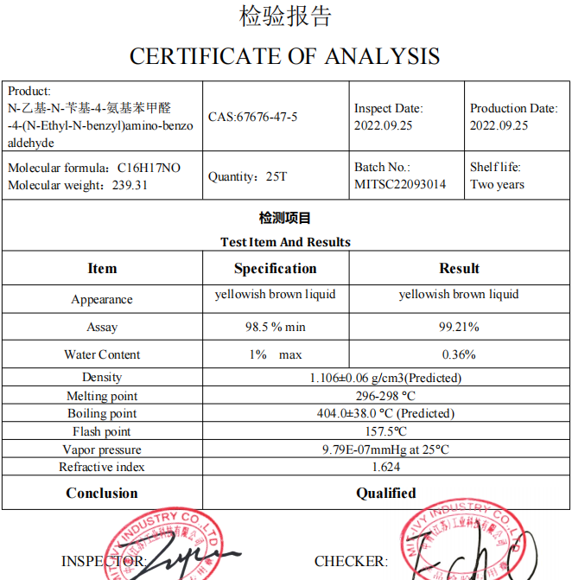
4-(N-Ethyl-N-benzyl)amino-benzo aldehyde
CAS:67676-47-5
Uses: dye intermediate, pharmaceutical intermediate

Slide 47
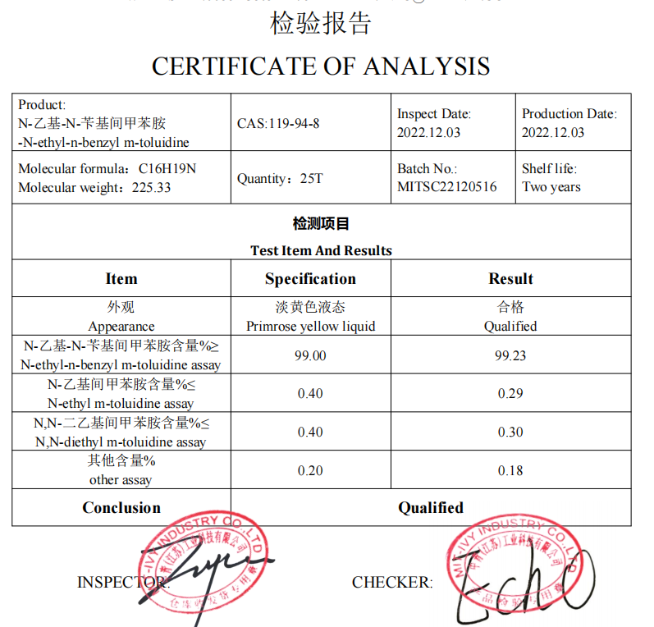
N-ethyl-n-benzyl-m-toluidine
CAS ：119-94-8
Uses: Used in organic synthesis, as intermediate of acid blue 90, 91, 109 and other dyes

Slide 48

Triethylenetetramine
CAS ：112-24-3
Usage: 1. Used as room temperature curing agent of epoxy resin;
2. Used as organic synthesis, dye intermediates and solvents;
3. Used in the manufacture of polyamide resins, ion exchange resins, surfactants, lubricating oil additives, gas purifier, etc.
4. Used as metal chelating agent, cyanide-free plating diffusion agent, rubber auxiliary agent, brightener, detergent, dispersant, etc.;
5. Used as complex reagent, dehydrating agent of alkaline gas, fabric finishing agent, ion exchange agent resin, polyamide resin synthesis raw material;
6. Used as a vulcanizing agent for fluorine rubber.

Slide 49

1,3-Dichlorobenzene MDCB
CAS:541-73-1
Application: 1. For organic synthesis. 2,4, ω-trichlorophenone was obtained by reaction of M-dichlorobenzene with chloroacetyl chloride in Friedel-Crafts, which was used as the intermediate of the broad-spectrum antifungal drug Miconazole. Chlorination in the presence of ferric chloride or aluminum-mercury mainly produces 1,2, 4-trichlorobenzene. In the presence of catalyst, m-chlorophenol and resorcinol were hydrolyzed at 550-850℃. Using copper oxide as catalyst, M-phenylenediamine was synthesized by reaction with concentrated ammonia water at 150-200℃ under pressure.
2. Used in dye manufacturing, organic synthesis intermediates, solvents.

Slide 50
N-ethyl-n-benzyl-m-toluidine
CAS ：119-94-8
Uses: Used in organic synthesis, as intermediate of acid blue 90, 91, 109 and other dyes

Slide 51
4-(N-Ethyl-N-benzyl)amino-benzo aldehyde
CAS:67676-47-5
Uses: dye intermediate, pharmaceutical intermediate

Slide 52

Trifluoromethanesulfonic acid TFSA
CAS:1493-13-6
Use: 1. It is widely used, and it is one of the strongest organic acids known to us. It is a versatile synthesis tool. With strong corrosion, hygroscopicity, widely used in pharmaceutical, chemical and other industries. Such as nucleosides, antibiotics, steroids, proteins, carbohydrate, vitamin synthesis, silicone rubber modification and so on.
2.Trifluoromethanesulfonic acid is a strong organic acid commonly used in the laboratory, which can be used to prepare trifluoromethanesulfonic anhydride and a variety of trifluoromethanesulfonic acid derivatives, trifluoromethanesulfonic acid is also an effective catalyst for oligomerization and polymerization of alkenes and ethers.

Slide 53

SODIUM SULFATE
CAS:7757-82-6
Uses: This product is used as medicine salting agent, flocculant, also used in paper, glass, printing and dyeing, synthetic fiber, leather and other industries

Slide 54

2,3-Dichlorotoluene
CAS ：32768-54-0
Uses: dye intermediate, pharmaceutical intermediate

Slide 55



Company Advantages
5. Professional R&D technology team and equipment which keep products quality better and better..
1. Goverment support guarantees good company credibility and finance safe，so we can do DA 60 DAYS
6. Timely after-service resolves your worry for internation trade
2. MIT-IVY is confident at the quality of the products, and would like to supply free sample to our customers
3. Factory locates in national new material industrial park where guarantees safe and standard production enviroment
4. More than 23 years chemcial production and exporting experience, and good relationship with Customs and ship agents, which guarantee fast and safe export.

Slide 56



Our service
1. Certificate Of Analysis (COA)
2. Material Safety Data Sheet (MSDS)
3. Route of synthesis (ROS)
4. Method of Aanlysis (MOA)
5. Nuclear Magnetic Resonance (NMR)
6. Any inquiries will be replied within 12 hours.
7. Dedication to quality, supply & service.
8. Strictly on selecting raw materials.
9. Reasonable & competitive price, fast lead time.
10. Faster delivery:Sample order in stock and one week for bulk production.
11. We have strong cooperation with DHL, TNT, UPS, FEDEX, EMS. Or you also can choose your own shipping forwarder.

Slide 57


BEST CHOICE
Strategic cooperation

Slide 58
MIT-IVY INDUSTRY
工
中
业
青

